Slide 1
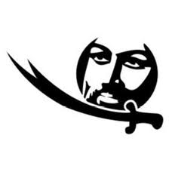
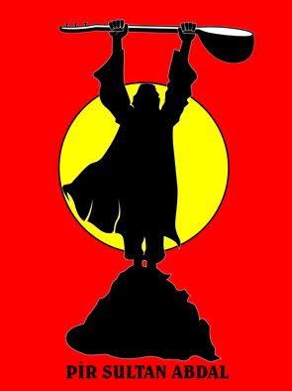
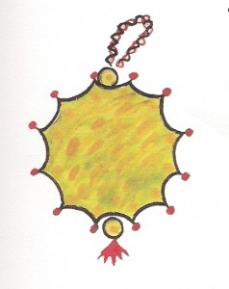
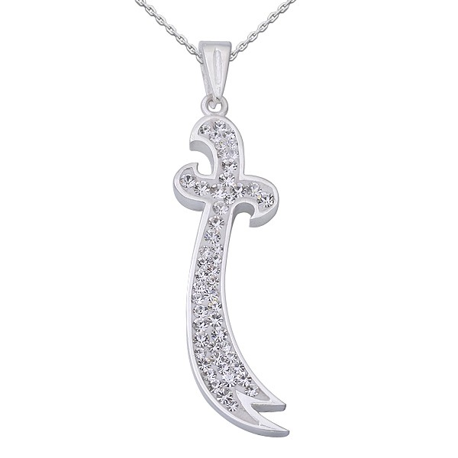
2. What are the roots of key Alevi beliefs and practices?
Objective: To learn about the geography, history and philosophy of Alevism.
Notes:
What did the students identify as the most important beliefs from last week?

Slide 2
Recap: feedback from homework
Which beliefs did you found interesting? Why?
What are your views?
We will now look at where these beliefs come from and get a better idea of what Alevism is by finding out about its development and history
Notes:
Discuss 1 and 2 together taking suggestions from the class. Allow volunteers, but also ask some individuals specifically.

Slide 3
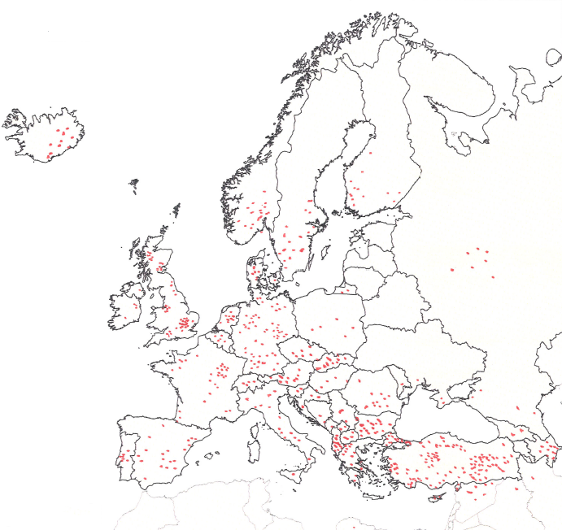
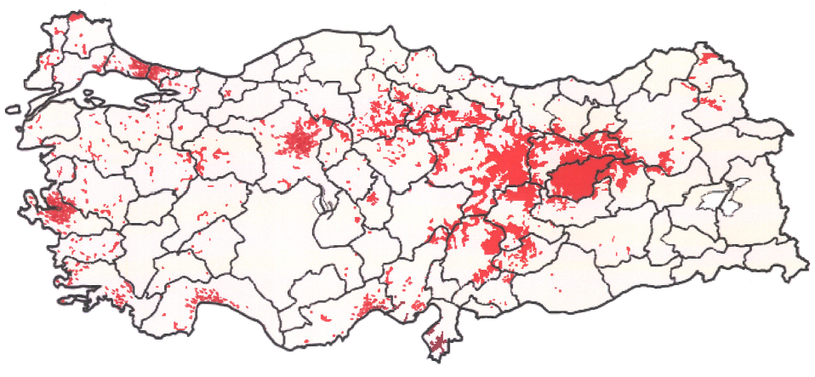
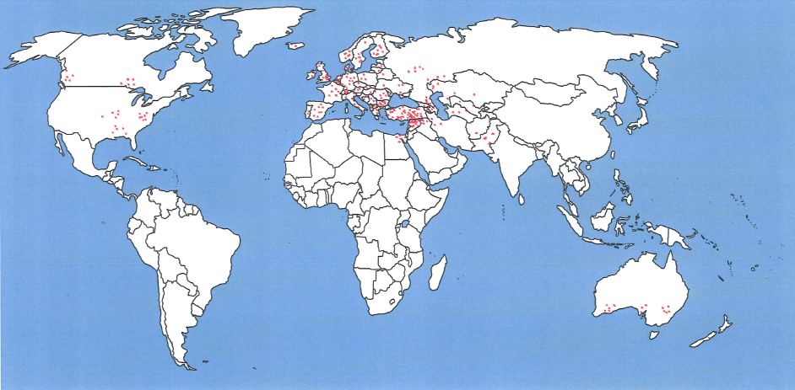
Where do we find Alevis?
Alevism started in rural Anatolia (now in Turkey) and has spread through Europe and around the world. Why would Alevis move from their home to other parts of the world?
Notes:
Present this briefly as information. Started in Anatolia, but migrations, especially in 1980s (?) to Europe. We don’t need to focus too much on populations etc, but it might be helpful to inform students that there are substantial and important Alevi communities in Germany and the UK.
Ask for initial responses to the question in red, but state that this is something they will be learning over the next few weeks and is an important question to consider when looking at Alevi identity. We can then come back to this in the last lesson.

Slide 4
What has influenced Alevism?
Judaeo-Christian Muslim Traditional Eastern (eg Buddhism)
The roots of Alevism lie perhaps in pre-history and it has been influenced by many beliefs and cultures.
Notes:
Discuss briefly the deep roots of Alevism with some spiritual beliefs and practices from pre-historic and traditional Anatolian and central Asia (eg significance of the crane) and from different religions such as Shi’a Islam. Tell students that they should be looking for examples of these as they learn more about Alevism.
Point out the geographical position and how this meant that through trade, culture and warfare, Anatolia was influenced by many different traditions.

Slide 5
Who are the Alevis?
Belong to different language and cultures with shared beliefs which have evolved over time.
Origins disputed because there is no written record:
Present at time of Moses
Some believe it as a branch of Abrahamic religions
Links to mystical traditions of Sufism in C13th
Turkish/Kurdish, Chinese, Indian, Iranian, and Arab beliefs and culture, mixed with old Anatolian and Christian beliefs.
Notes:
Explain how, largely through the influence of Hace Bektas-Veli, these beliefs and cultures came to shape and influence what we now call Alevism.
The name itself refers to Ali – ask if any students know who Ali was. Point out that for Alevi, Ali is not the historical figure, but a symbol of the ideal human being.

Slide 6
Two main figures of Alevism
Hünkar Bektaş-i Veli (1281-1338)
Founder of the
Bektaş-i lodge
St. Ali (601-661) is the first imam of 12 who are sacred persons in Alevism
Notes:
Introduce these to show that the roots of Alevism are complex. You can remind students of the statements about Ali and humanity in the ‘basic beliefs’ sheet.

Slide 7
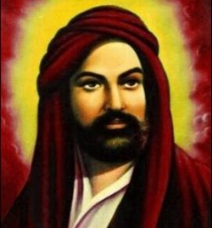
Ali (601-661)
“Mazlumun yanında, zulmün karşısında ol”
“Allegiance with the oppressed and stand against tyrants” (Does this mean war?)
“Bana bir kelime öğretenin 40 yıl kölesi olurum” Hz. Ali
“I will serve for 40 years those who teach me one word”
Ali represents
Respect, peace, love, equality, sharing, protection, trust, responsibility, justice,
knowledge, freedom, philosophy, righteousness, honesty, learning, education, teaching
Notes:
WHO IS ALI?
COUSIN TO MOHAMMED AND THE ORIGINAL LEADER OF ALEVISM discuss briefly the qualities he represents – why are they important to Alevi? What difference might this make in a young person’s life?
Ali is respected for his courage, knowledge, belief, honesty, devotion to Islam, deep loyalty to Muhammad, equal treatment of all Muslims and generosity in forgiving defeated enemies.
Role-models for Alevi families. Who are your role models and why?
The Perfect Human Being.
Although it is common to refer to Ali and Haji Bektash Veli or the other Alevi saints as manifestations of the perfect human being, the Perfect Human Being is also identified with our true identity as pure consciousness, hence the holy concept of human beings not having original sin, consciousness being pure and perfect. The human task is to fully realise this state while still in material human form.
The Perfect Human Being is also defined in practical terms, as one who is in full moral control of his or her hands, tongue and loins (eline diline beline sahip); treats all kinds of people equally (yetmiş iki millete aynı gözle bakar); and serves the interests of others. One who has achieved this kind of enlightenment is also called eren or munavver.

Slide 8
Look at this image:
Can you name the bird and the two animals?
What is unusual about them?
What do you think this image might represent?
Notes:
Look at this image:
Can you name the bird and the two animals?
Dove
Gazelle
Lion
What is unusual about them?
You would not expect to see the lion sitting next to the gazelle without attempting to eat it and the gazelle would be frightened to be anywhere near the lion. As indeed with the human!
What do you think this image might represent?

Slide 9
The story of Hünkar Bektaşı Veli
https://www.youtube.com/watch?v=4pYRR8Slw6A
What do the images of the dove, lion and gazelle represent?
What is meant by the ‘internal struggle’? Think of a time you have had an internal struggle.
‘Only when the internal battle is won, will the external battles cease.’ What does this mean?
Notes:
WATCH THE CLIP FROM YOUTUBE. (show up to 5m 20s max)
It might be a good idea to pause the video after key phrases or information to ask what it means and clarify either understanding or significance

Slide 10
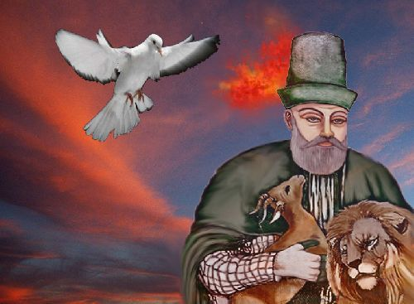
Hünkar Bektaşı Veli (1281-1338)
Founder of the Hünkar Bektaşi Veli lodge in C13th
Teachings based on humanism, peace, tolerance and clemency.
Dove = Peace, oppressed, inoffensive
Gazelle = leniency, clemency, satisfaction
Lion = tolerance, indulgence, forbearance
“Düşünce karanlığına ışık tutanlara ne mutlu” Hünkar Bektaşı Veli
Glory to those who shed light to dark thoughts.
“Arifler hem arıdır hem arıtıcı” Hünkar Bektaşı Veli
Enlightened ones both purify and are purifiers
Notes:
Hünkar Bektas-i Veli...His spiritual doctrine is accepted as one of the earliest form of universal humanism symbolized with the unity of a gazelle with a lion.
According to legend Hünkar Bektaş Veli came to Anatolia in the form of a dove there being no more inoffensive creature. The dove is a perfect image because Hünkar Bektaş Veli was a Perfect Man who came to Anatolia in the war, massacre, blood and tears of the 13th century as a source of peace and affection to nurture the souls of Anatolian people. Hünkar Bektasi Veli Picture: With the gazelle on one side and the lion on the other, he dreamed of a world in which the wolf and lamb, the gazelle and the lion could lived in peace together.
But he was not referring to the gazelle and lion of the external world, he meant the lion and gazelle within us. Personality and Existence, Body and Soul, A world in which the external male and female are reconciled. The road to world peace goes through internal peace, this is the essence of all ancient teachings.
THE IMPORTANT MESSAGE IS TO GET A BALANCE BETWEEN YOUR ANGER AND DESIRE (AS REPRESENTED BY THE LION) AND SATISFACTION WITH YOUR LIFE WITHOUT BEING GREEDY (REPRESENTING THE GAZELLE) TO GAIN HARMONY IN THE MIND AND SOUL.

Slide 11
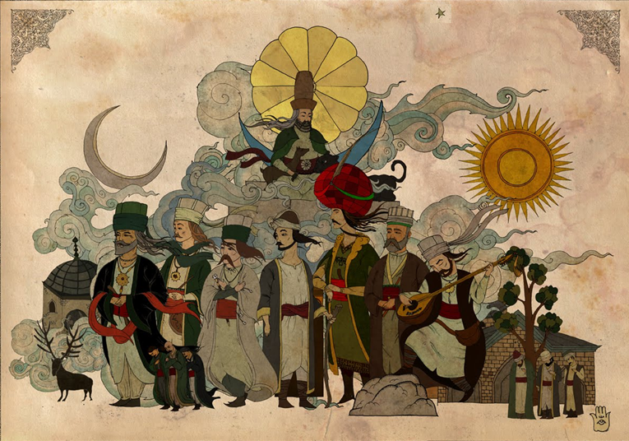
The 7 Great Poets
Pir Sultan, Virani, Yemini, Nesimi, Hatayi, Fuzuli, Kul Himmet
Notes:
Picture top: Hünkar Bektaşi Veli
Picture Left to Right:
Pir Sultan Abdal,
Virani Baba,
Yemini,
Seyyid Nesimi,
Shah Ismail Hatayi,
Fuzuli,
Kul Himmet

Slide 12
Importance of 7 Great Poets
Alevi books were destroyed and Alevis were forbidden to practice their religion for centuries.
The Great Alevi poets and many other Alevi poets passed on Alevi beliefs and their way of life through their poems, hymns and songs with the saz.
Which is why the saz is referred to as the “holy book with a string”
Notes:
Use or remind them of some of the poems and hymns from the first lesson. ASK WHY POETRY IS SO POWERFUL and get them to think of lyrics that mean a lot to them.

Slide 13
Homework
In the Identity booklet p2, explain some of the key Alevi beliefs and explain your own. (Challenge: how do these beliefs affect the way people/you live?)
On p7 of the booklet, explain how key figures from Alevi history and belief influence Alevi people. Who influences you and how? (These could be celebrities or friends and family.)
Notes:
CHOOSE ONE OF THE POETS AND DO SOME RESEARCH ON HIM. DO NOT RESEARCH PIR SULTAN OR H

