Slide 1
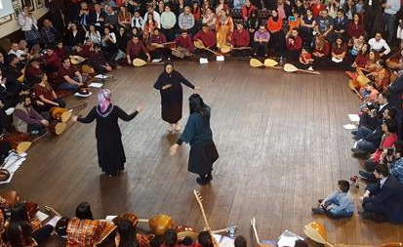
LO: I can identify the key roles of the volunteers who take part in the Cem ceremony.
Who are the 12 Servants and why are they important?
Notes:
1. Recap what you did last lesson and what they know about the Cem ceremony. Recap that a ceremony has set patterns. In the Cem ceremony, people take responsibility for some of the patterns and they are called the 12 Servants. Today we are going to learn about them. But first, we will look at our school!

Slide 2
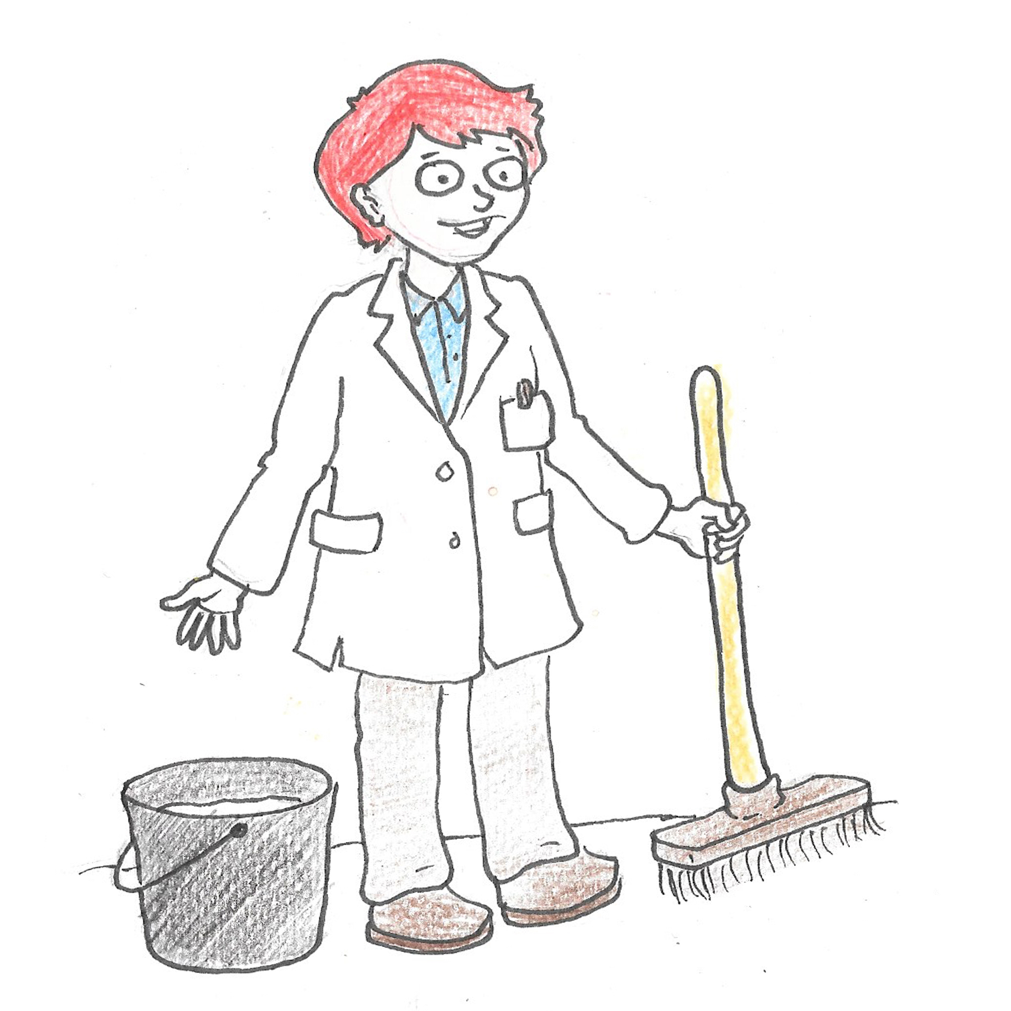
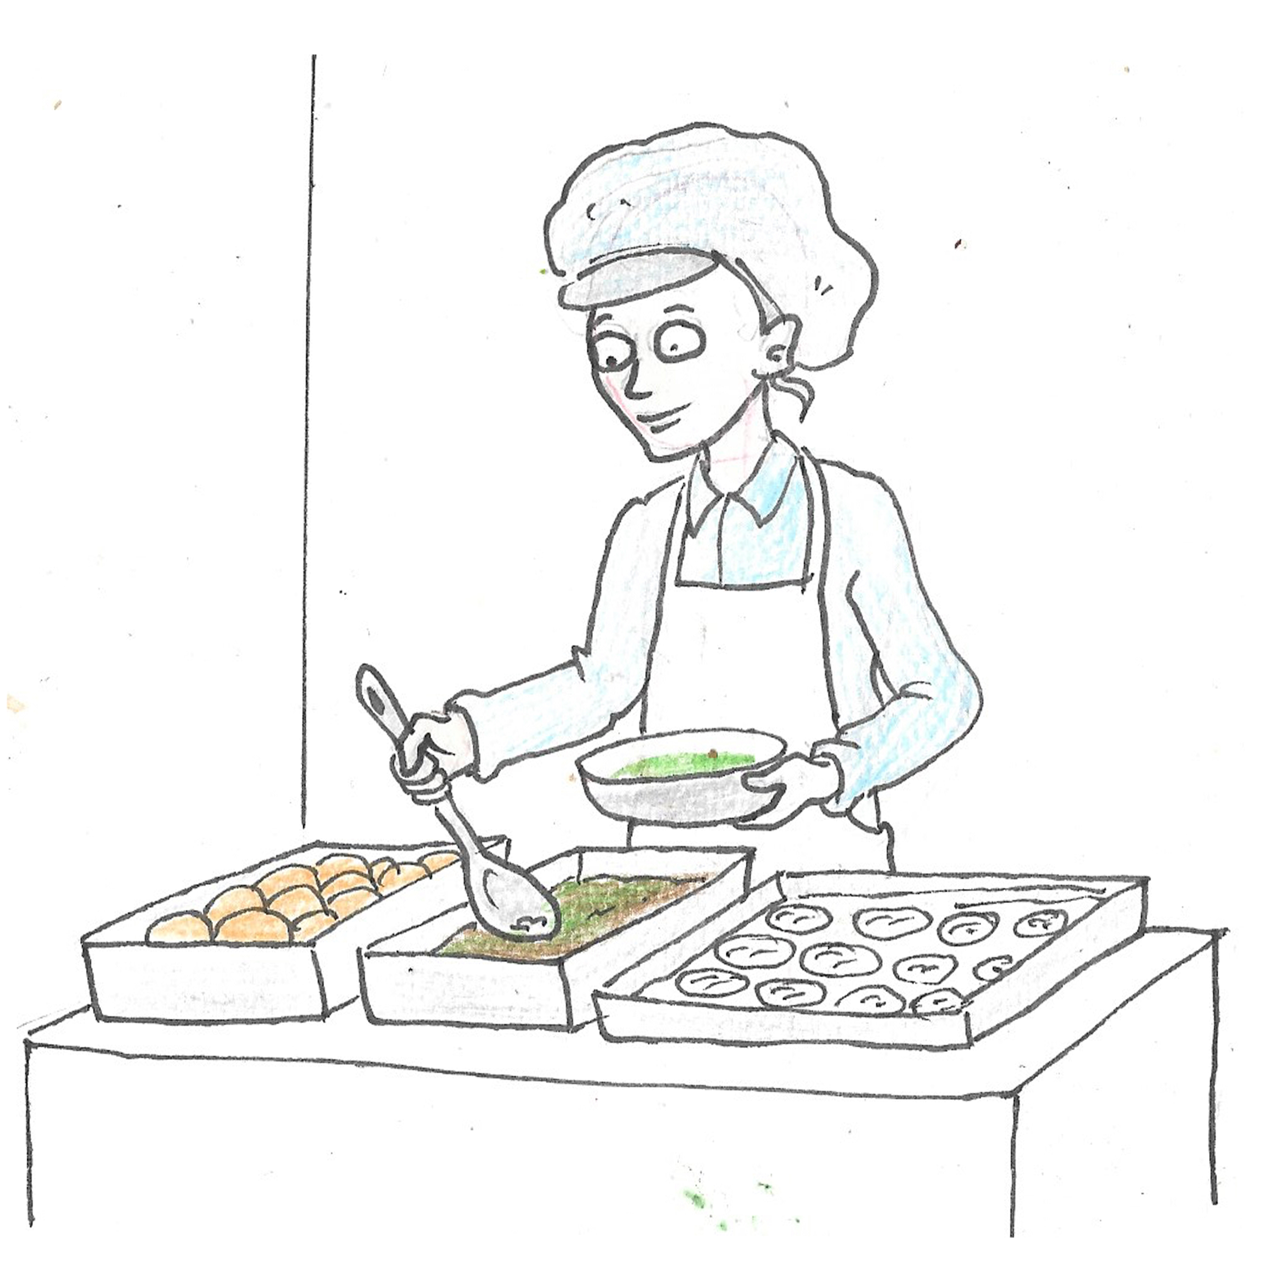
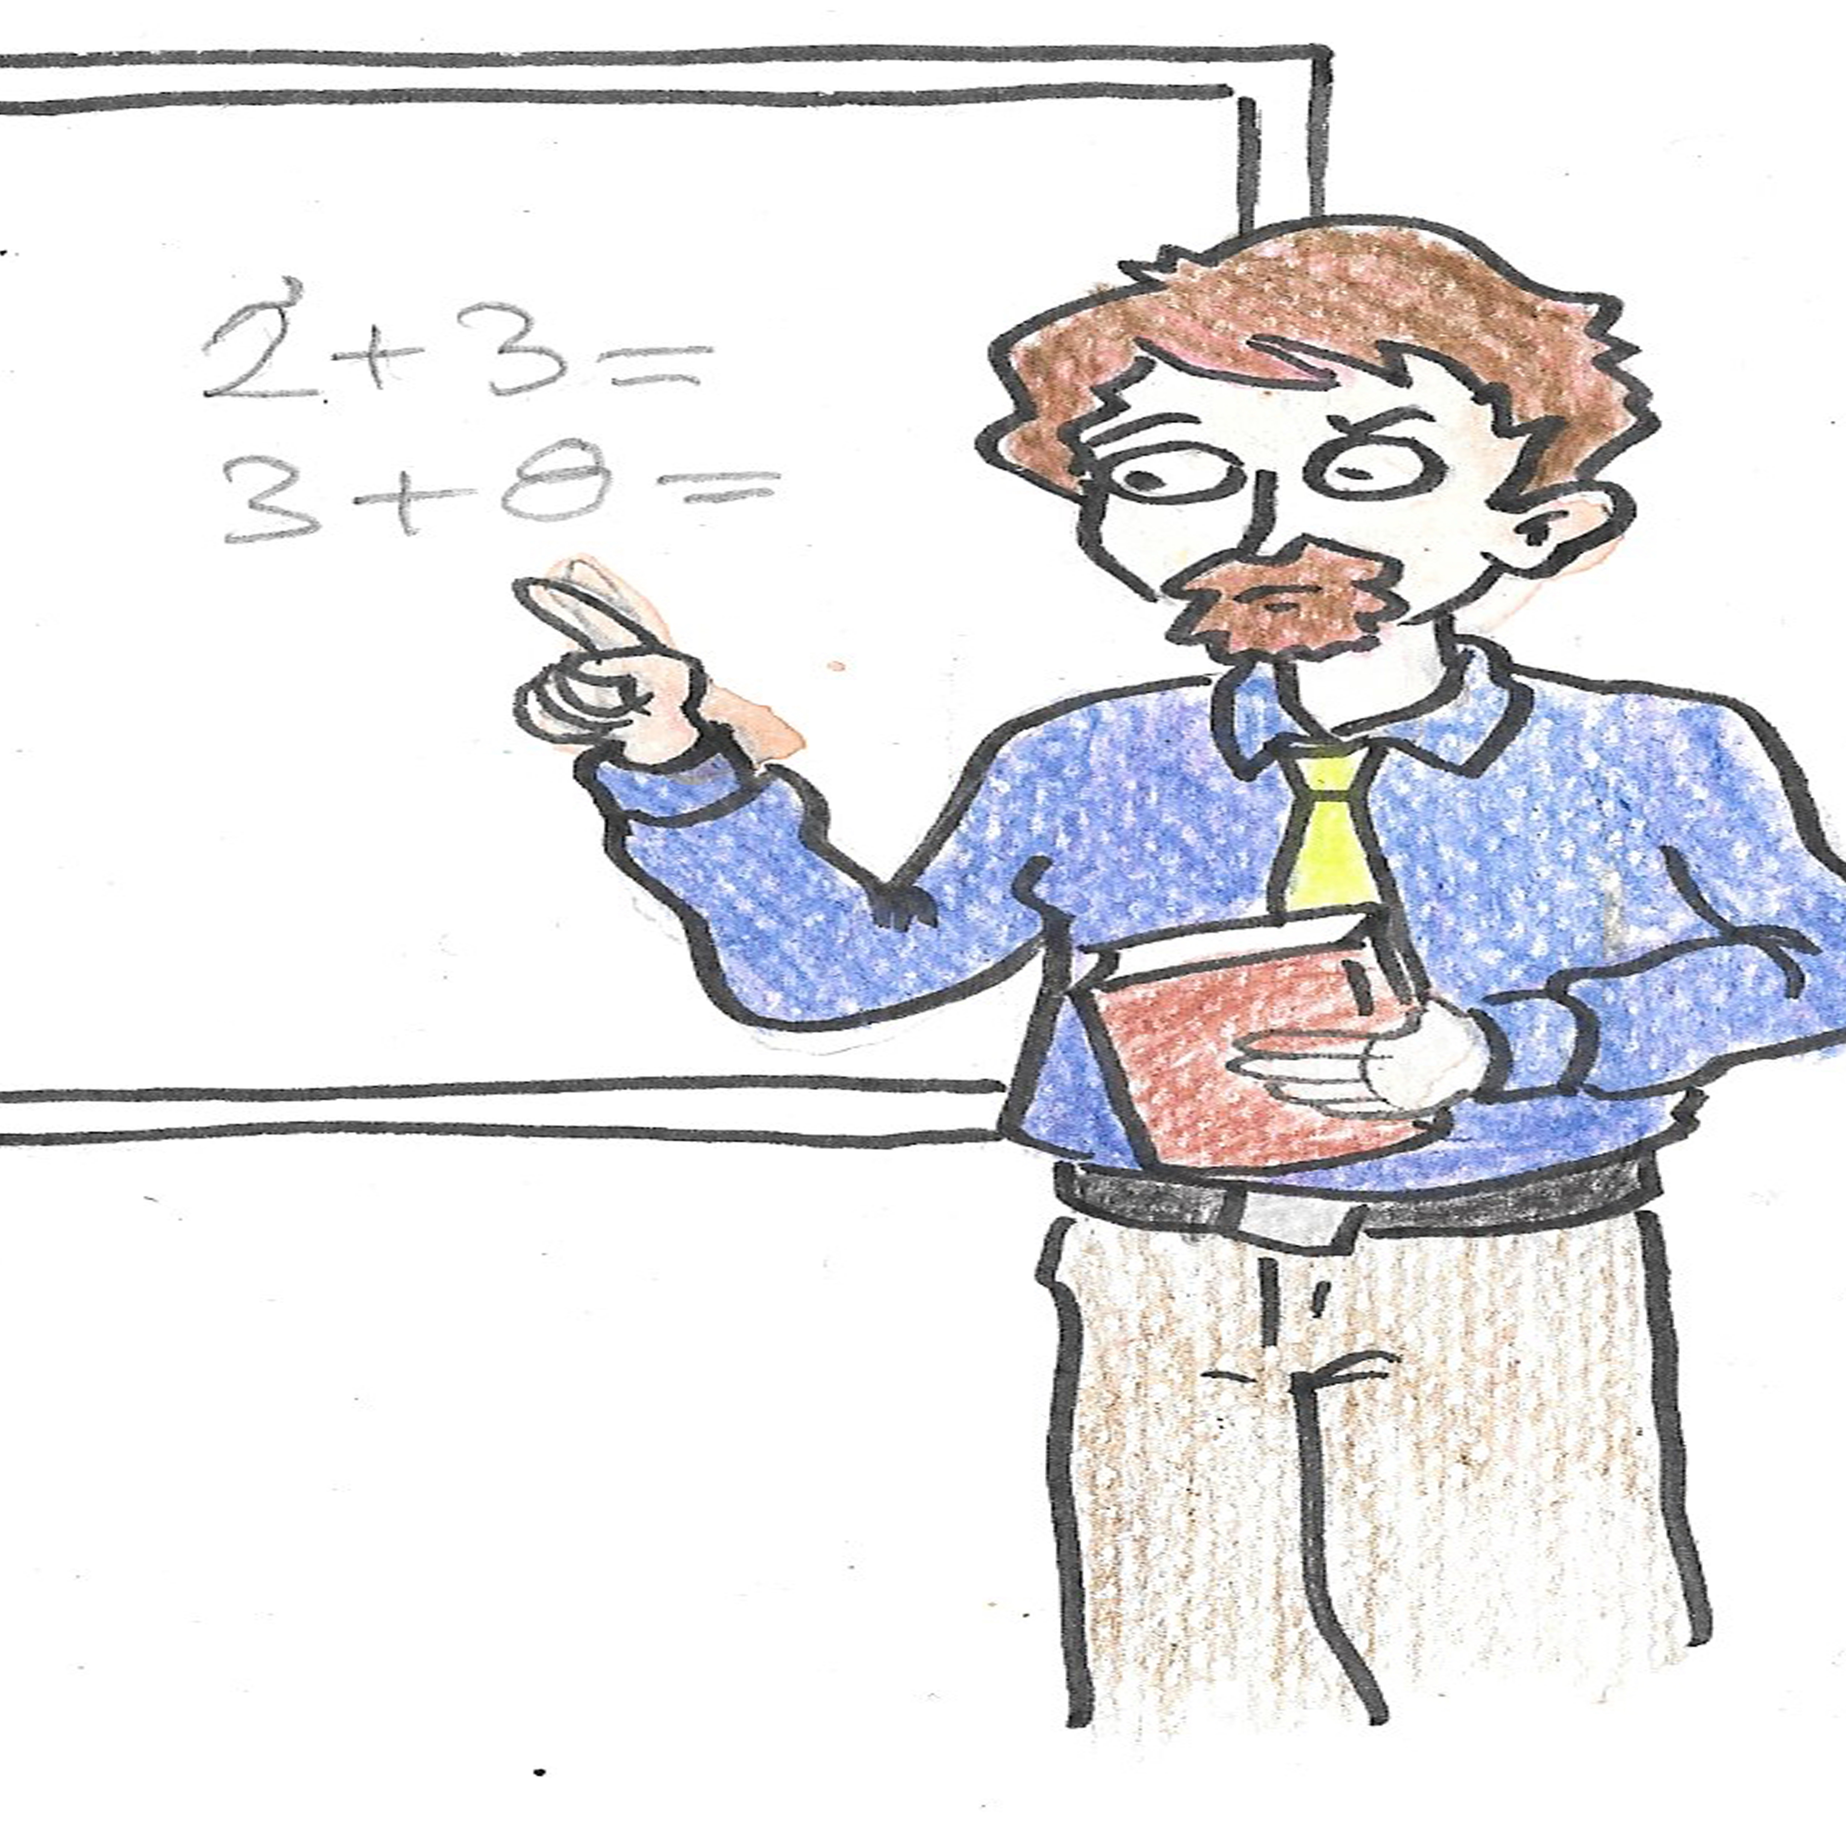
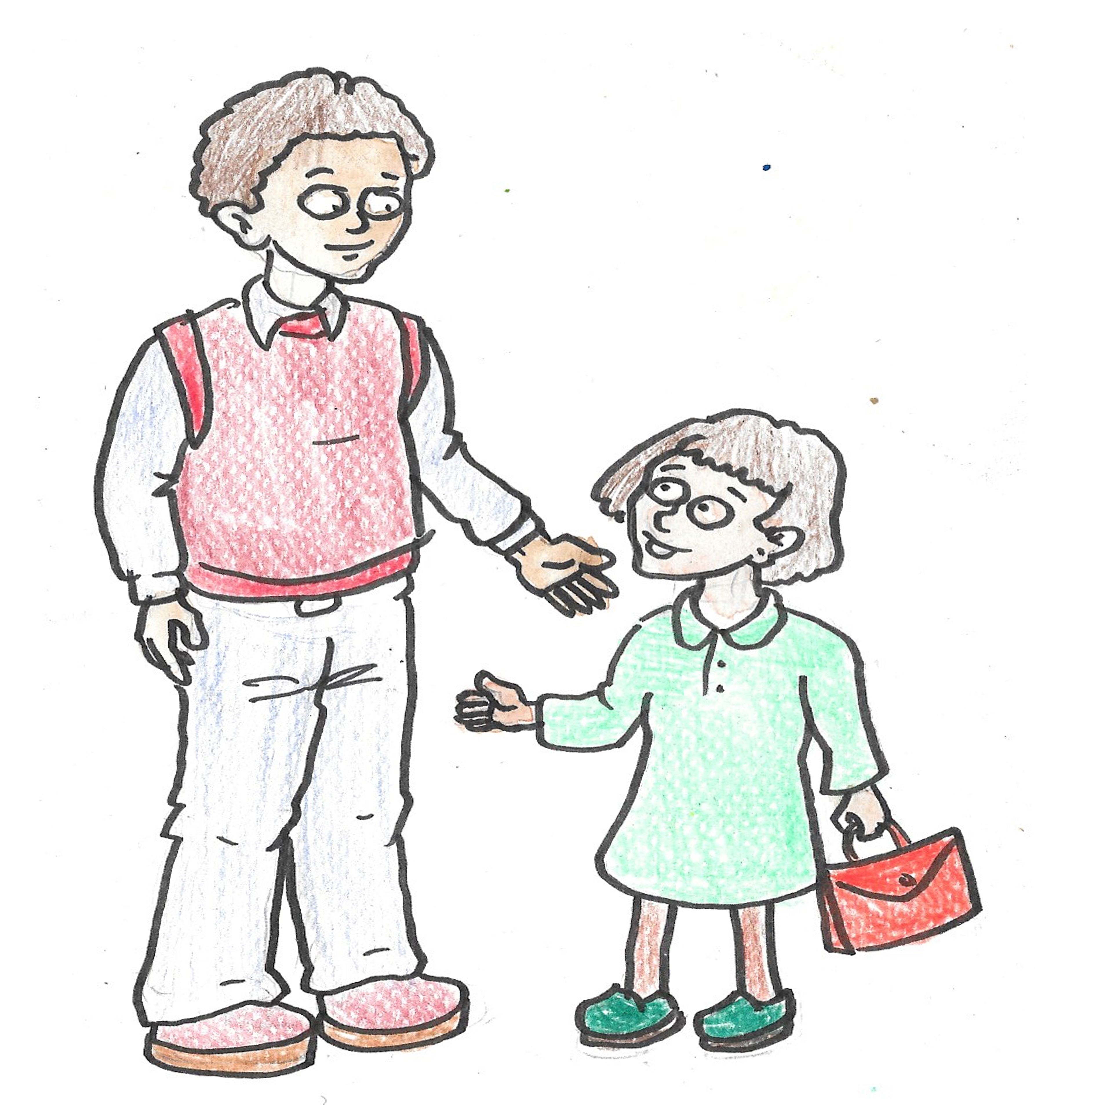
What is the role in this school of the:
Headteacher?
Caretaker?
Dinner Lady?
Teachers?
Pupils?
Parents?
Teaching Assistants?
Notes:
2. Discuss how all these people help each other and the shared purpose of learning in the school. Ask questions to get pupils thinking broadly and deeply about how they all contribute to learning. Are schools only there for learning knowledge and skills? What else do we learn at school?

Slide 3
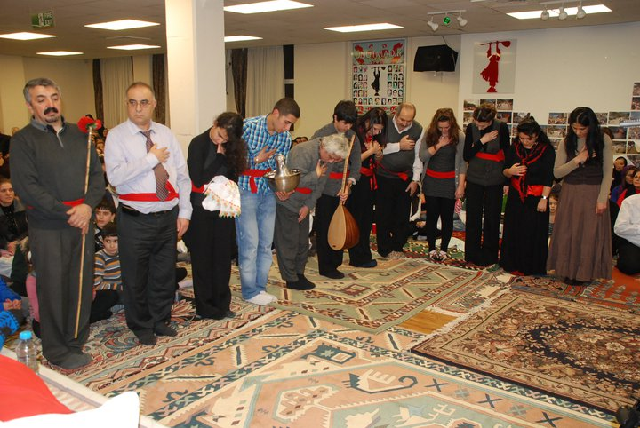
At the Cem ceremony there are 12 volunteers who have different roles.
Notes:
3. Any comments or questions about this picture? How do we know that these people think what they are doing is important? Discuss body posture and facial expressions. What is the focus of the room? How do we know? Some are carrying things. What can you see? What do you think they might be for?

Slide 4
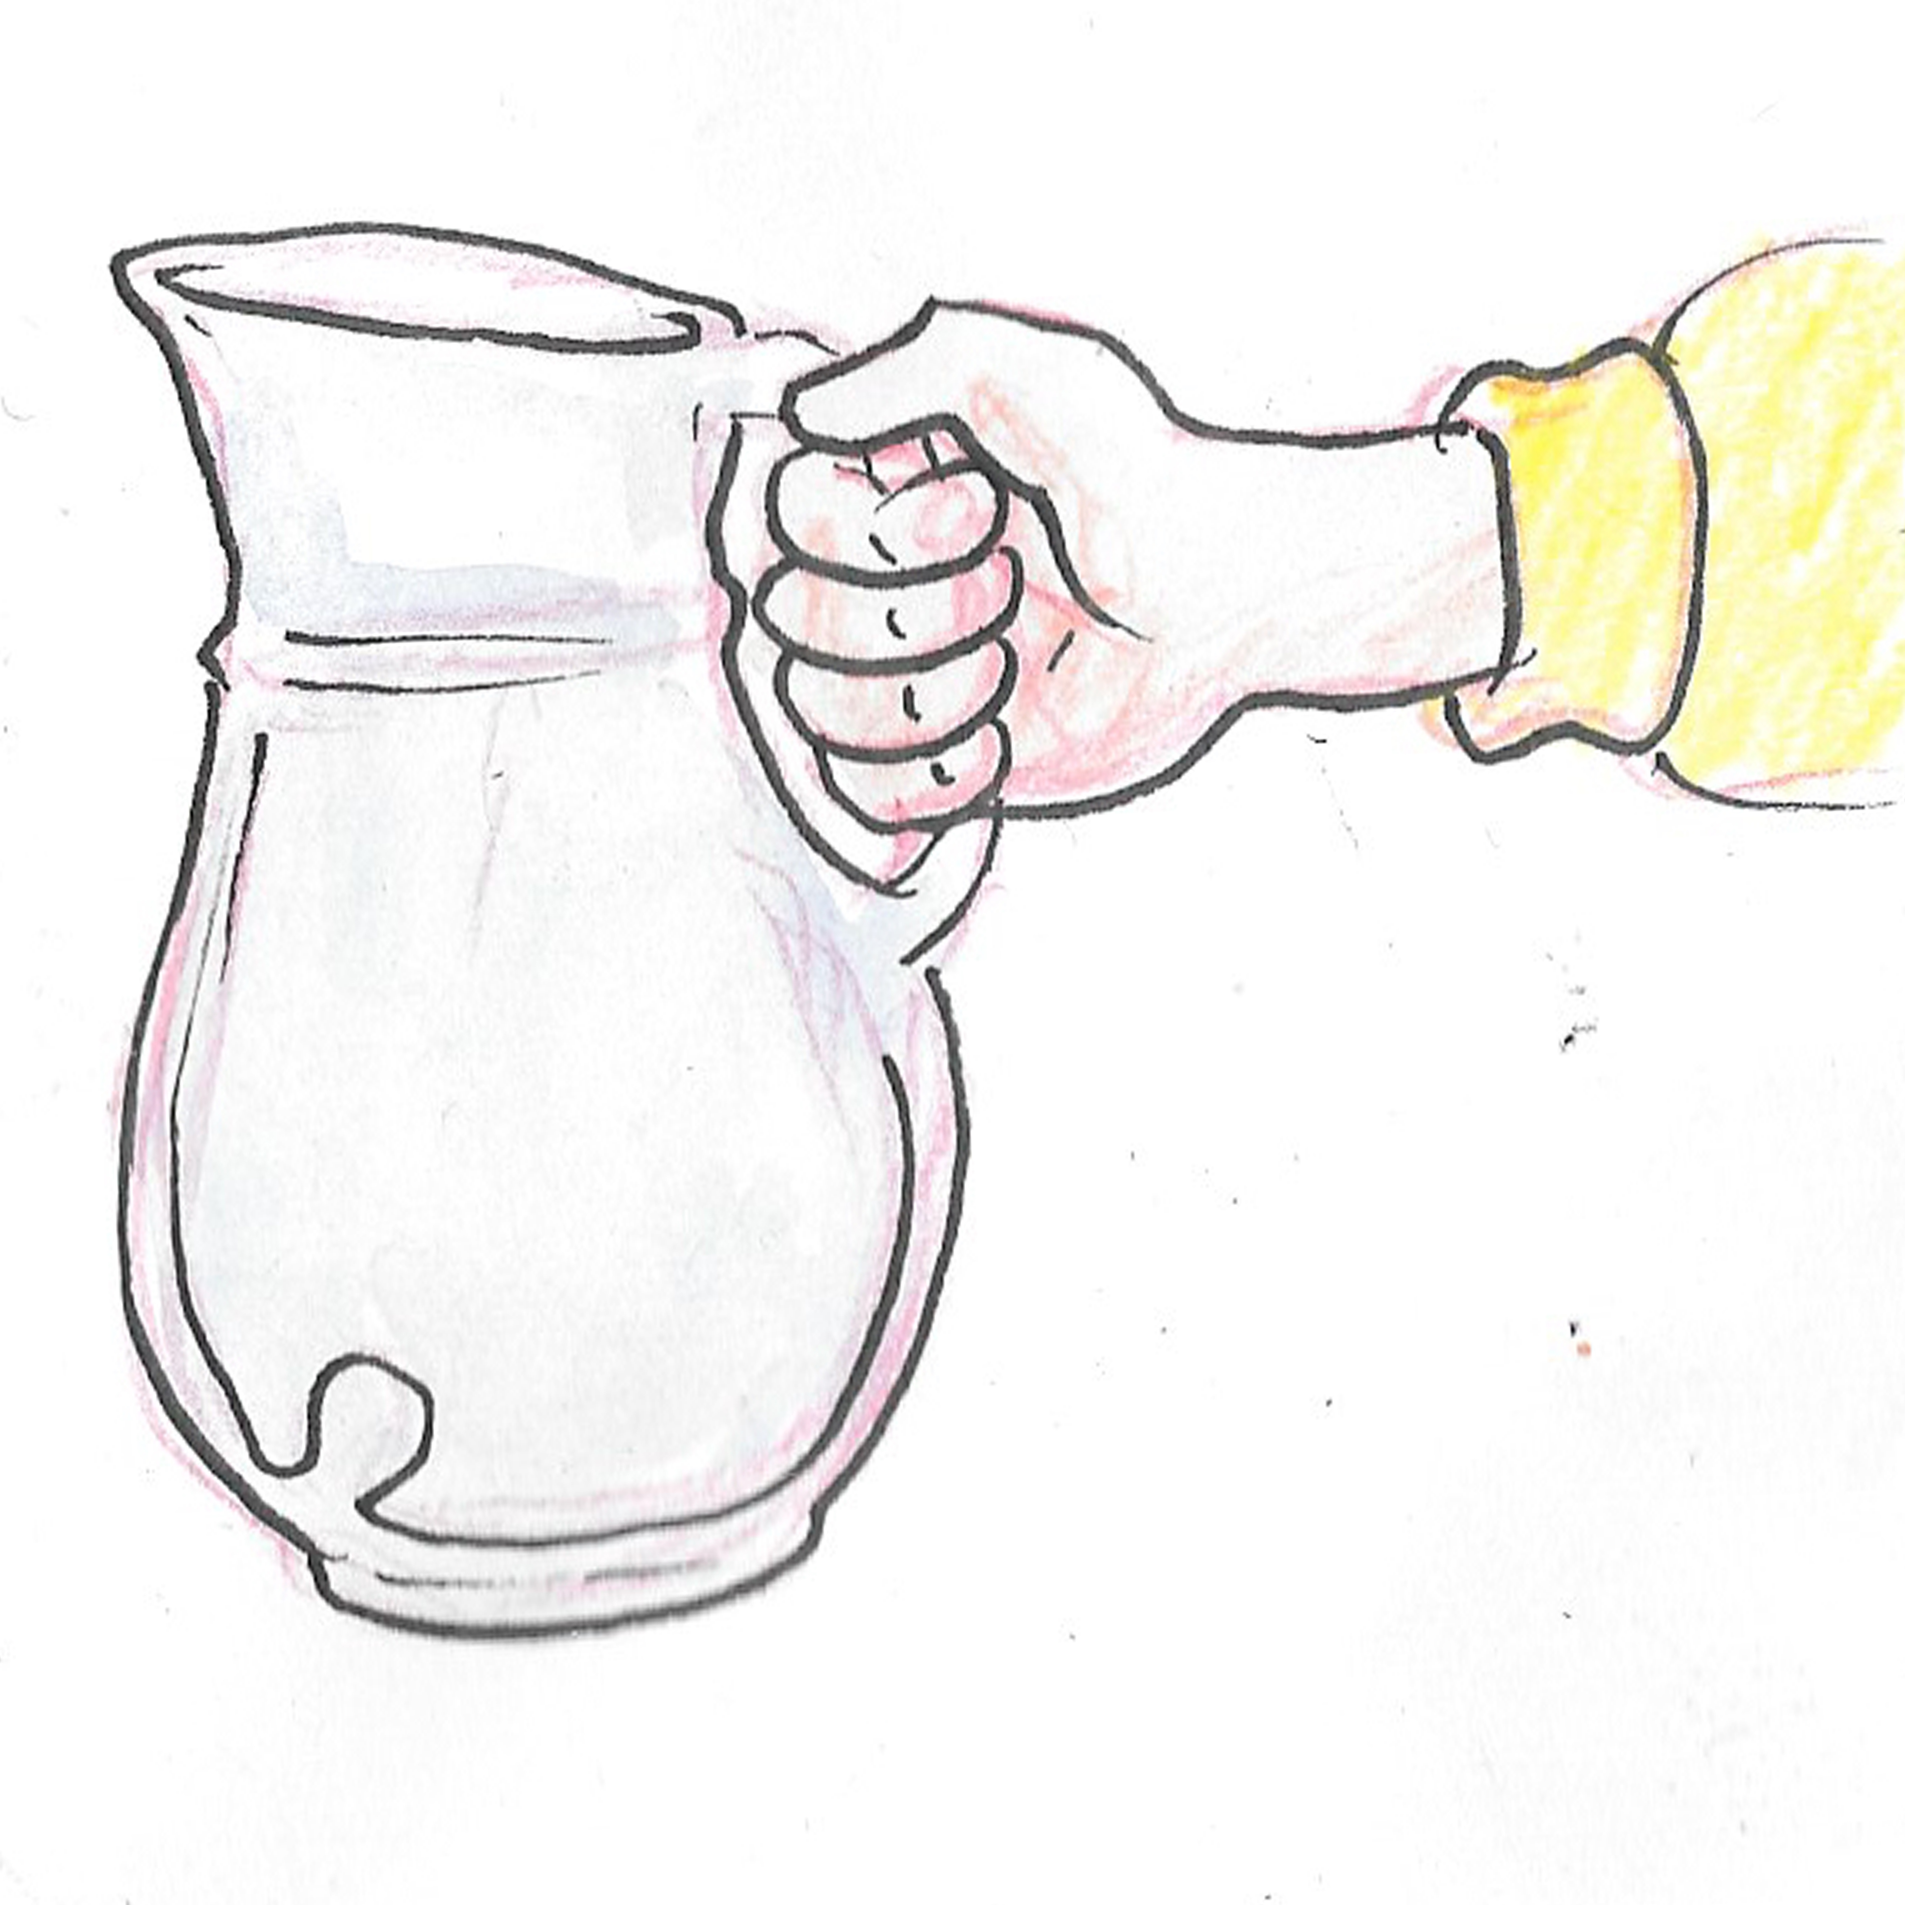
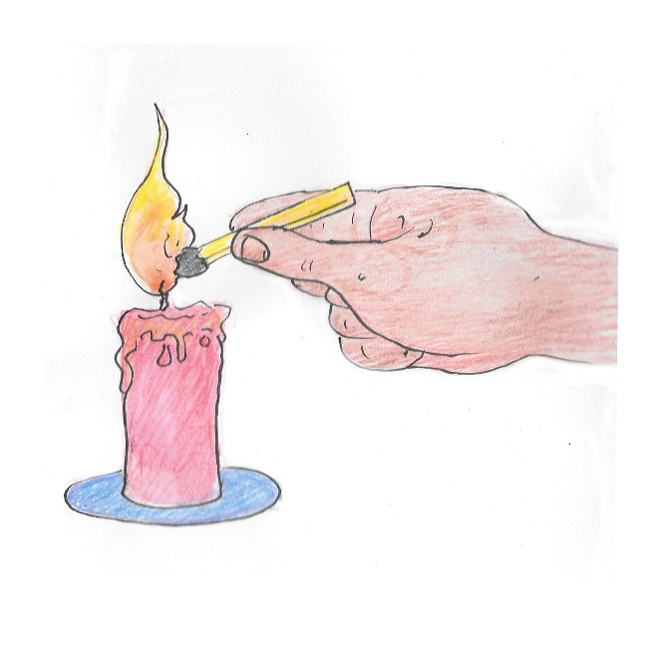
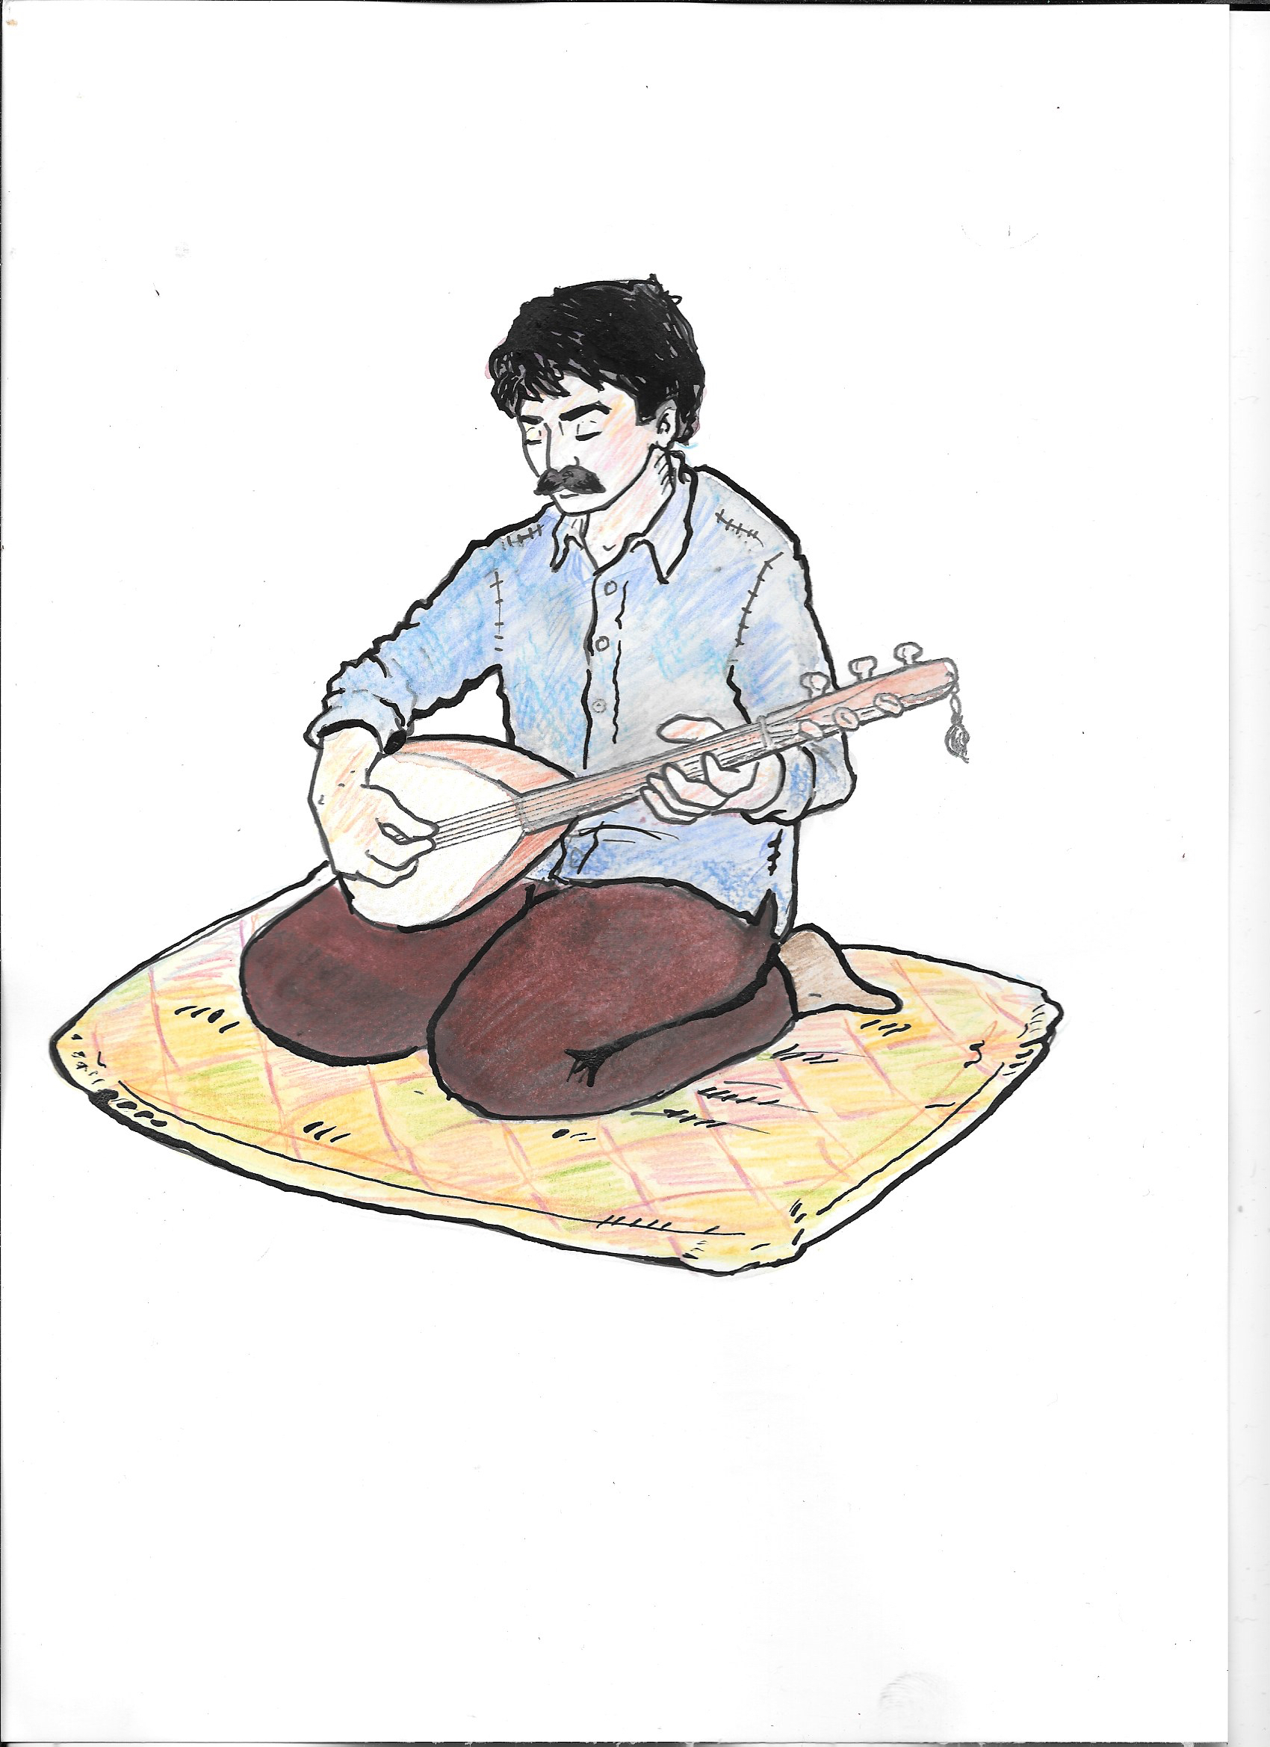
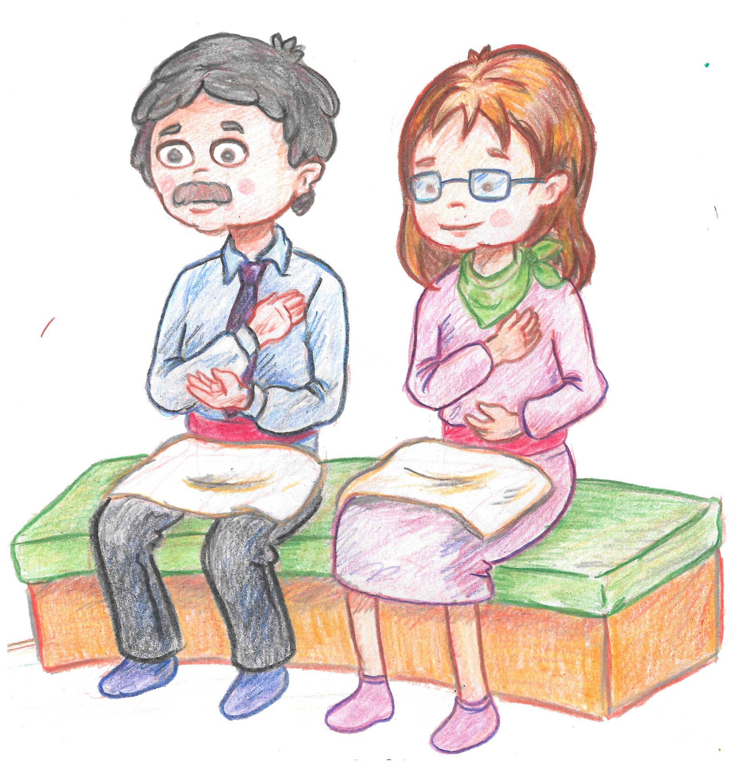
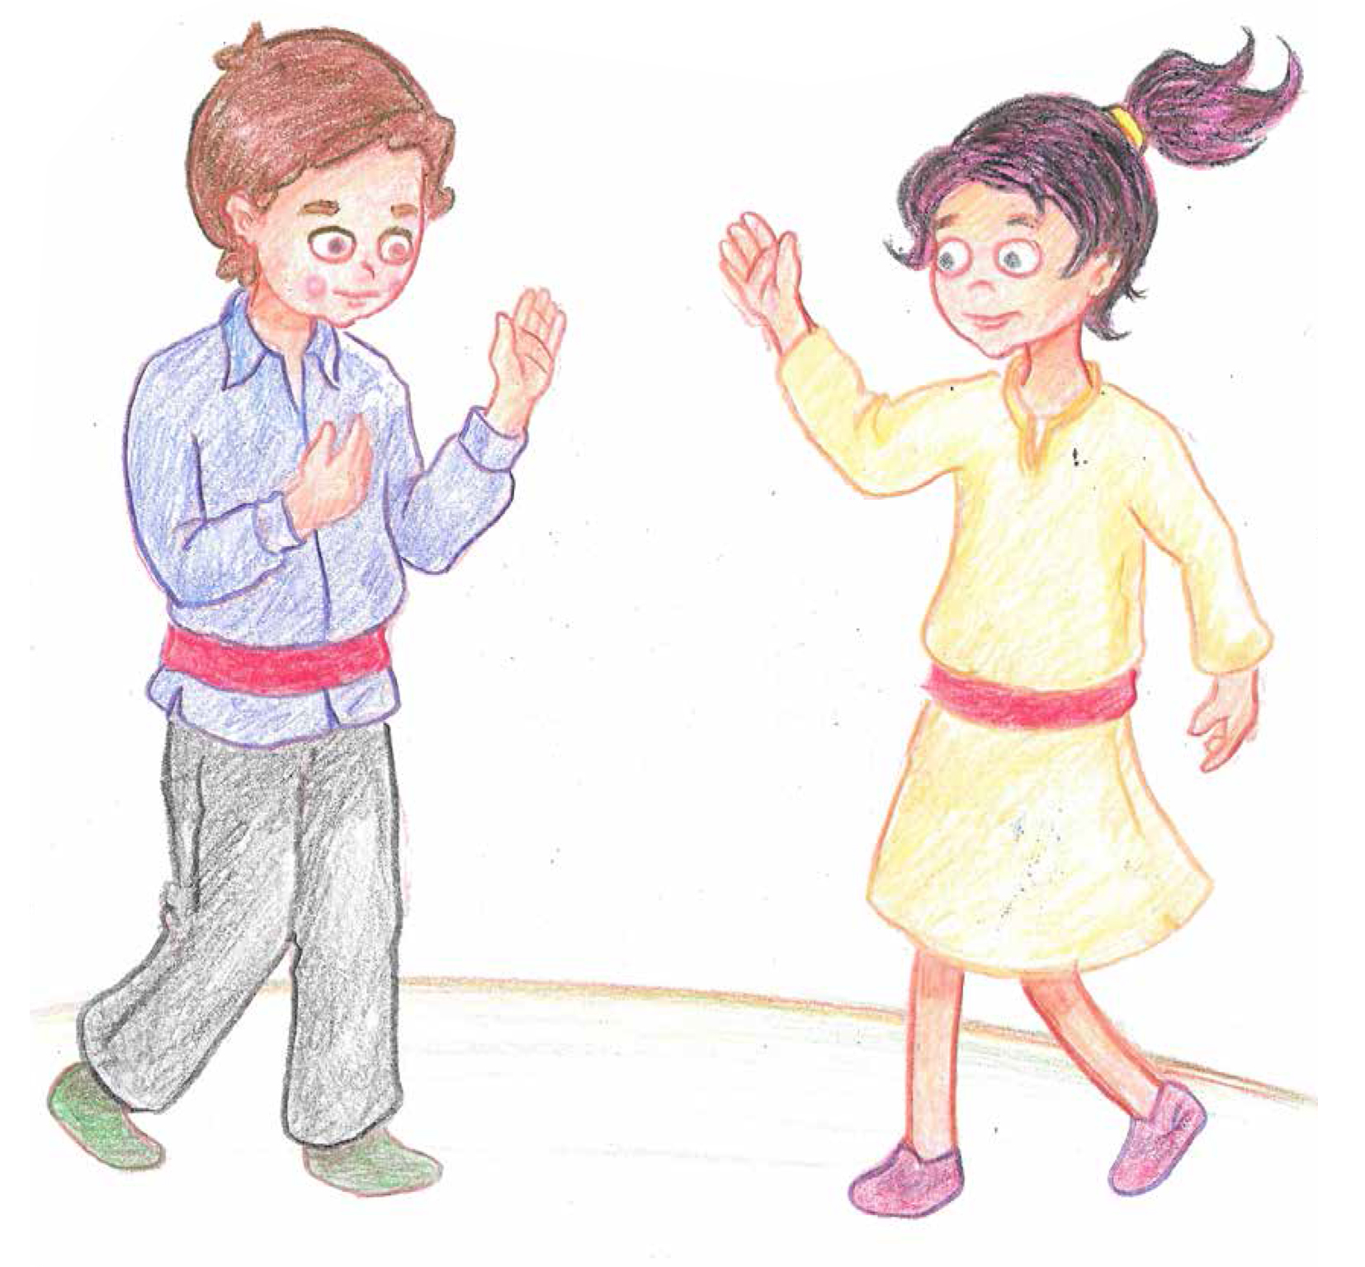
There are some clues in these pictures.
What do you think they might be?
Notes:
4. Briefly take ideas from pupils of what sort of services there might be.

Slide 5
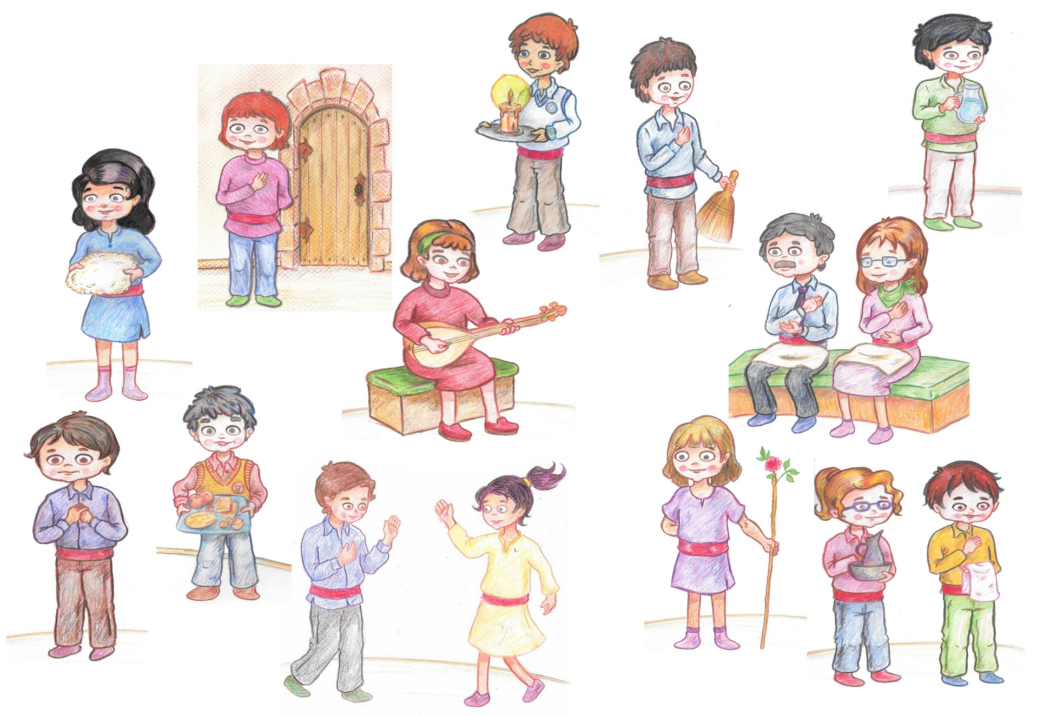
The 12 roles in the Cem ceremony
Notes:
5. The 12 servants play a critical role in the Cem ceremony. Without any one of them, the Cem would not be carried out properly.
Dede; ‘GRANDFATHER’ and/ or Ana: ‘MOTHER’ the leaders of the Cem Ceremony.
Guide, Zakir
The Observer, Door Keeper, Sweeper
Jug Server, Candle Lighter, Fleece Keeper
Semah Performers, Water Server, Food Server

Slide 6
Let’s watch the video of the Cem ceremony again.
Write down what each person does next to their picture on the sheet.
Which do you think is the most important service? Why?
Notes:
6. Make sure all children have a copy of the 12 Servants worksheet.
Click on the picture to activate the videoclip. This is the same video as last lesson. Stop the video to help the pupils and give them time to write down what each does. Alternatively, for some children you can use the matching cards.
When they have done this, ask them to think quietly in their own heads which is the most important role. They need to think of a reason for their choice. Now share their choice, with reason, with their talk partner. If they have chosen the same, have they the same reason? Why might someone disagree? If they have chosen differently, see if they can agree which one is most important and why. Then share as whole class. Can the class agree? The focus, though, needs to be on their reasons!
You will find information on the servants in the Cem booklet(s)

Slide 7
Worksheet Which do you think is the most important? Why? Is there more than one right answer?
Notes:
7. It is possible that all children will choose the Ana/Dede. If so, ask if there are any other possible candidates. The Cem Keeper? Semah? Fleece? Light? Some of these bring Hakk into the ceremony! What if someone didn’t do their bit? What would happen to the ceremony? On the other hand, they all sit in a circle – what does this say? Can the pupils remember where Alevis believe Hakk is? If Hakk is in everyone, can there be a most important person?!

