Slide 1
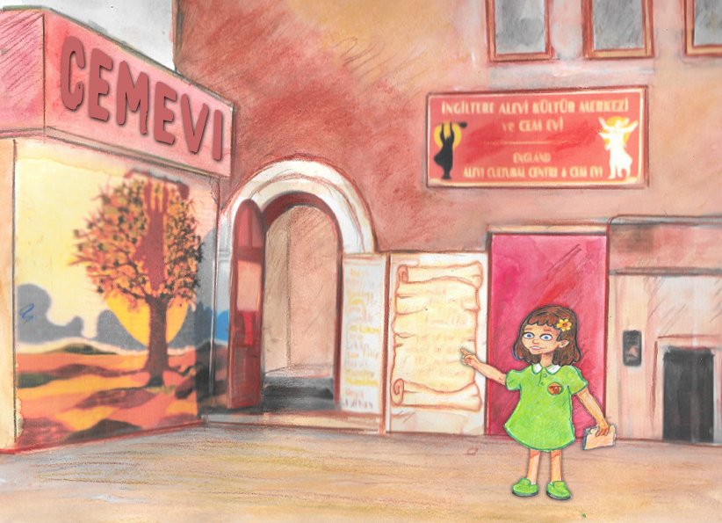
LO:I can describe what happens in a Cem ceremony.
What happens when Alevis worship together?
Notes:
1. Ask the children if anyone thinks they can say what worship is. Does anyone here go to worship? Where might different people go to worship? Does everybody worship?
Allow the children to share some ideas and experiences if they wish to, then say we will be finding out what happens when Alevis worship.
(See the info booklet on The Cem for your own information)

Slide 2
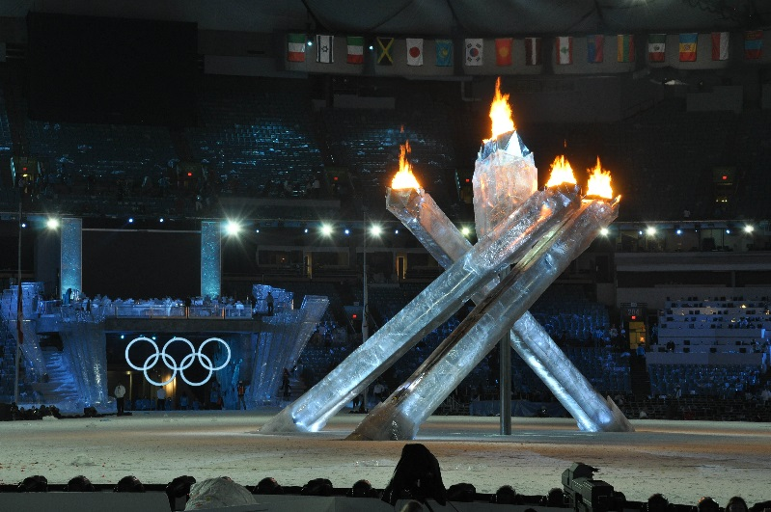
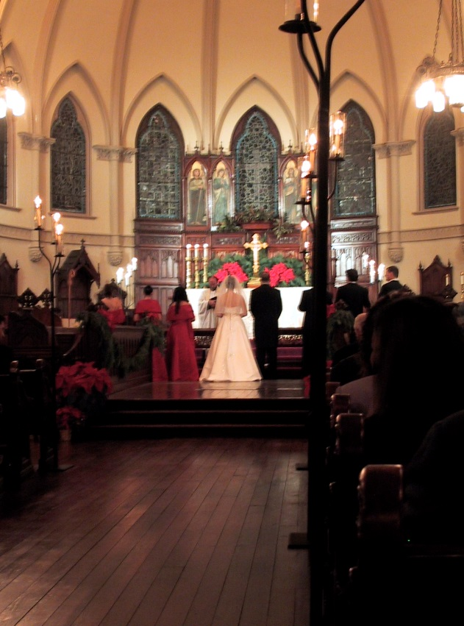
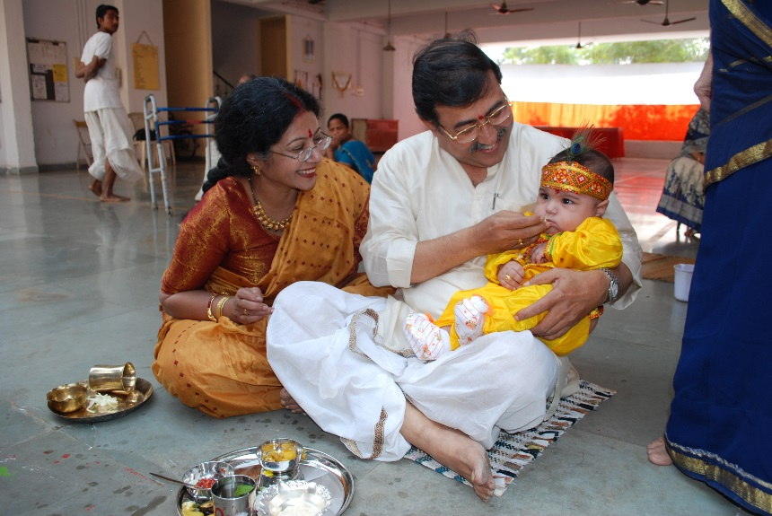
What is a ceremony?
Notes:
2. Ask pupils to say what they can see as each picture appears. Ask if anyone thinks they can say what might be going on in the picture. Can anyone suggest what they might all have in common?
Explore what is needed for a ceremony (special actions and order – ritual; special music, songs, poems, words…)
Have you ever been to or seen a ceremony? Discuss
List some of the features of a ceremony (special actions, clothes, order of doing things, music, etc)

Slide 3
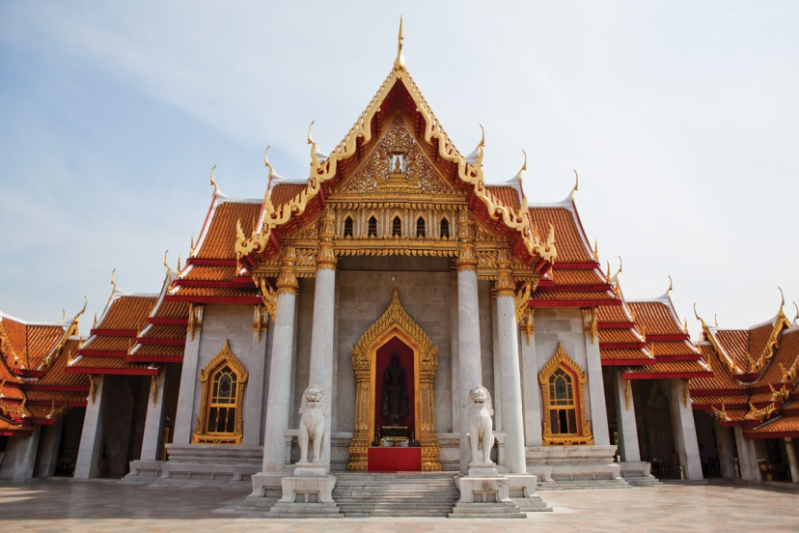
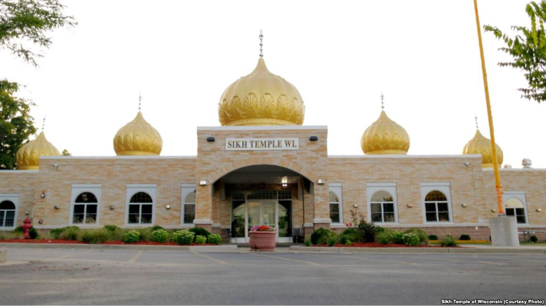
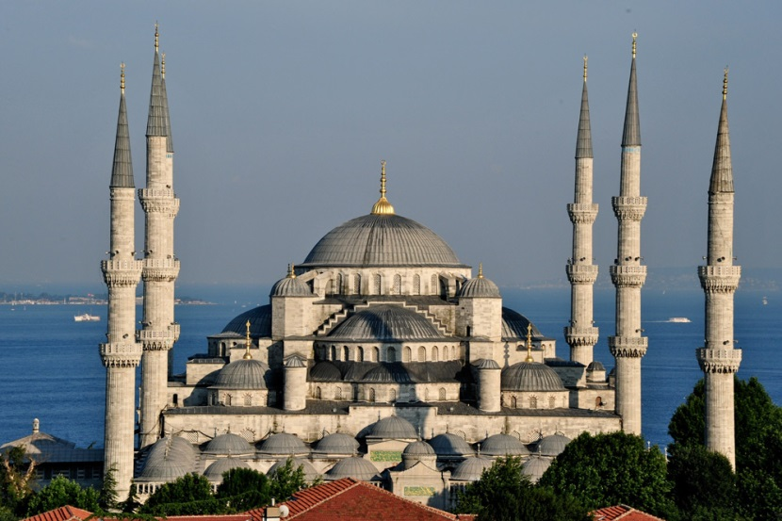
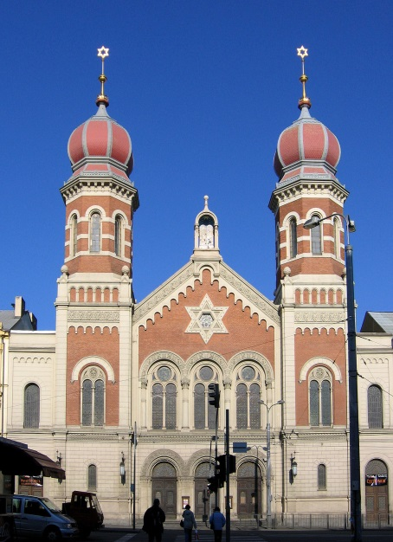
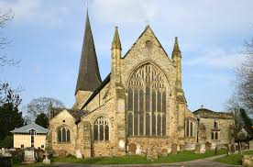
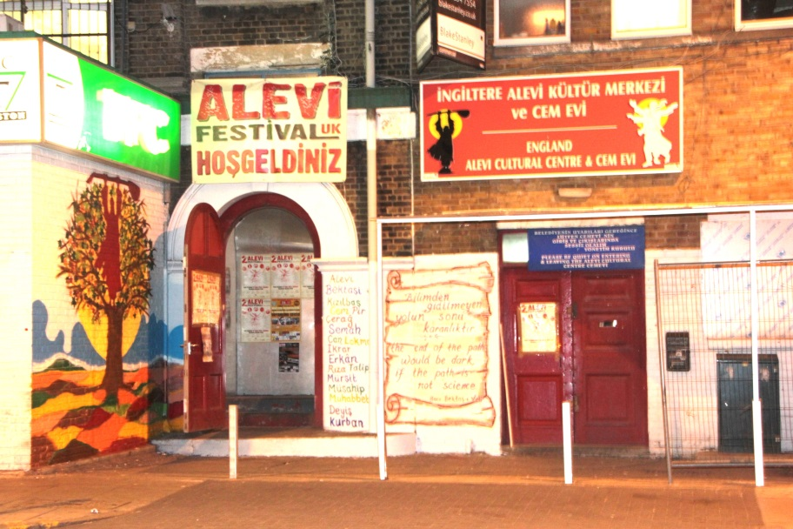
Where are religious ceremonies held?
Notes:
3. What do pupils notice about these pictures? How might they tell that these are important places for some people? Which one is the Alevi special place? How could they tell?

Slide 4
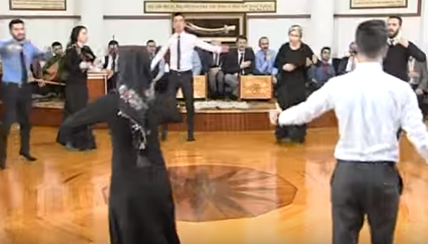
What happens in a Cem ceremony?
The Alevi ceremony is called the Cem (pronounced Jem!)
As you watch the video clip of a Cem ceremony, use the sheet to tick the things that you see happen.
Notes:
4. This video will be revisited , so just show it straight through without stopping. Then let the children describe the things that they ticked. What else did they see that is not on the sheet> Did they find anything particularly interesting?

Slide 5
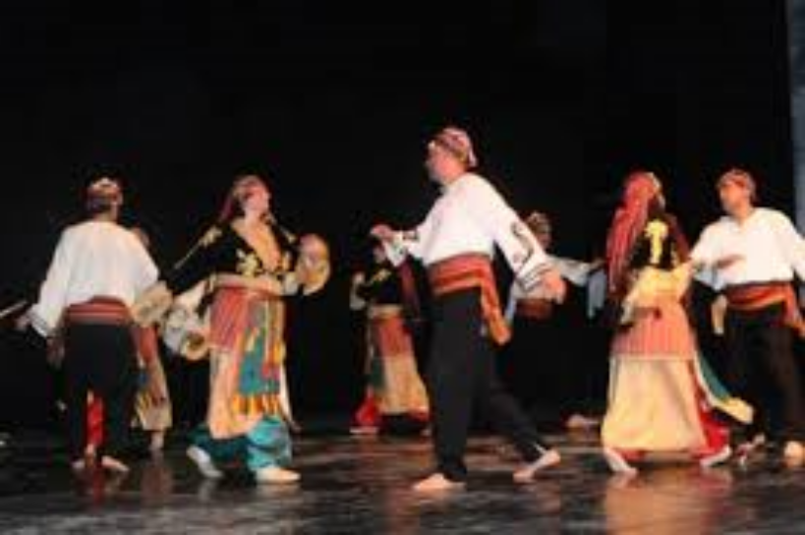
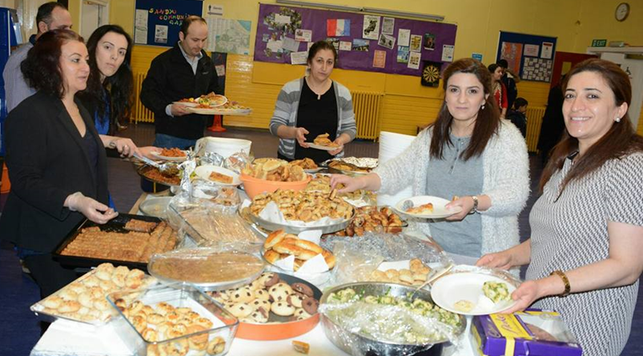
The Cem ceremony
They perform semah (religious dance)
They sing Alevi hymns with a saz
They eat lokma (shared meal) at the end of the ceremony.
Notes:
5. Using these pictures, get the children to talk about what happens and why they might be important. Link to their own experiences of music, dance and sharing food. How are they similar? How are they different?

Slide 6
Draw a picture in each box of something that happens in a Cem ceremony
Picture 1 | Picture 2
Picture 3 | Picture 4
Choose one and explain what is happening and why you think it is important
Notes:
6.This activity will help the children to focus on what happens in the Cem. As they are working, it is interesting and helpful to walk around and ask what they are drawing and why they chose that to draw. Before the end of the lesson, say that they will be learning more about the cem next lesson.

