Slide 1
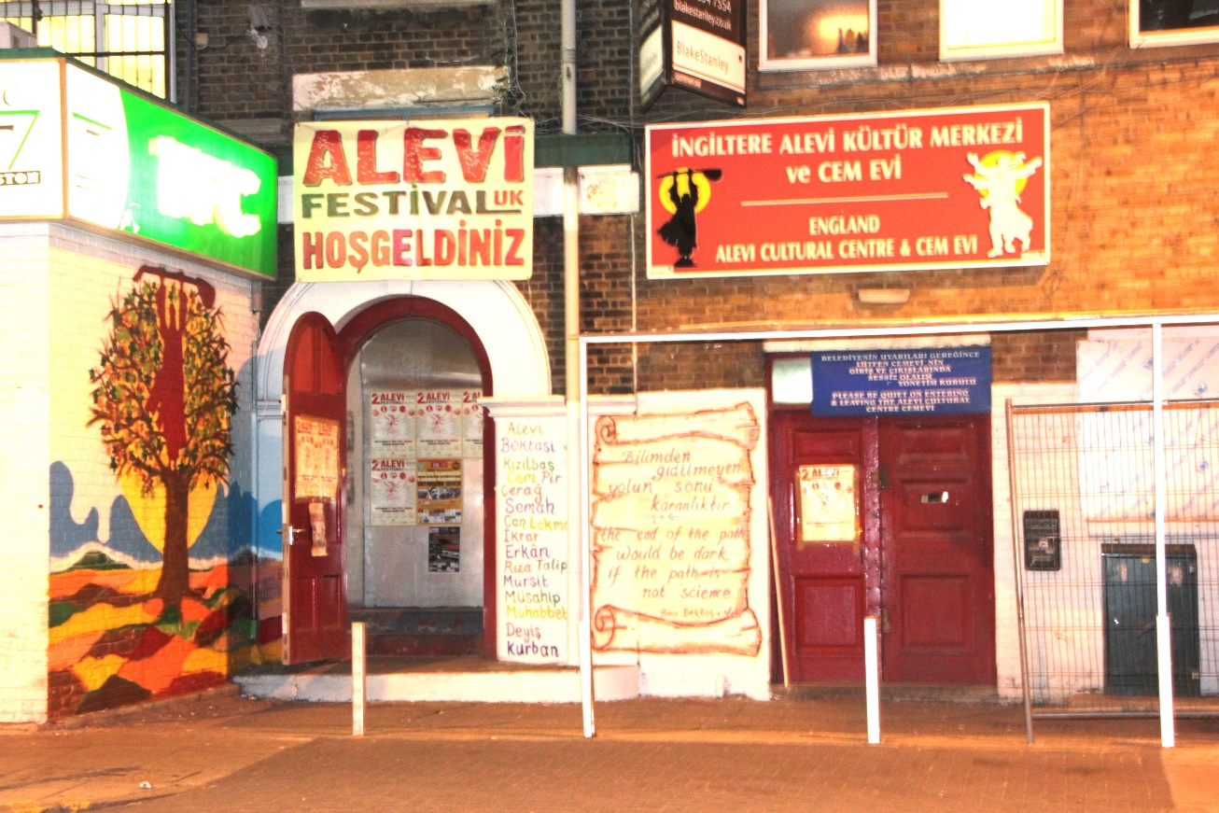
What does the Cemevi show about Alevi beliefs?
LKS2 Lesson 2
Notes:
1. This will be something for adapting to the needs and context of the pupils, depending on how much they already know (from KS1 for example) and whether there are Alevi children in the class.
There is a lot of information and a linked worksheet. The purpose is to encourage the children to think about how the Cemevi helps the Alevis to live out their religion and way of life. The rituals, the 12 services and especially the Semah express key beliefs. Focus on:
Hakk is in everyone. We need to look for Hakk/God in ourselves and in everyone
All people are equal
We should support the underdog
We should serve and help everyone in the community
We should all strive to be the best person we can be
This is achieved through the beliefs and teachings and practices of Alevism
The cemevi is where this takes place
Use questioning to build bridges between the material and the pupils’ experience as well as to get them to think.
Complex ideas such as ‘oppression’ will need careful handling and skilled unpicking by the teacher. This is an important dimension of Alevism and could be said to link to the purported tendency of British people to side with the under-dog. There are good links here with SMSC and ‘British values’ and could be a real opportunity to explore values and how they influence our behaviour.

Slide 2
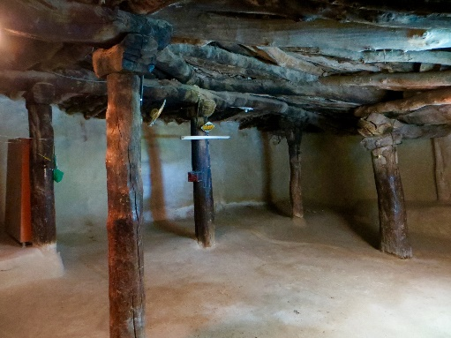
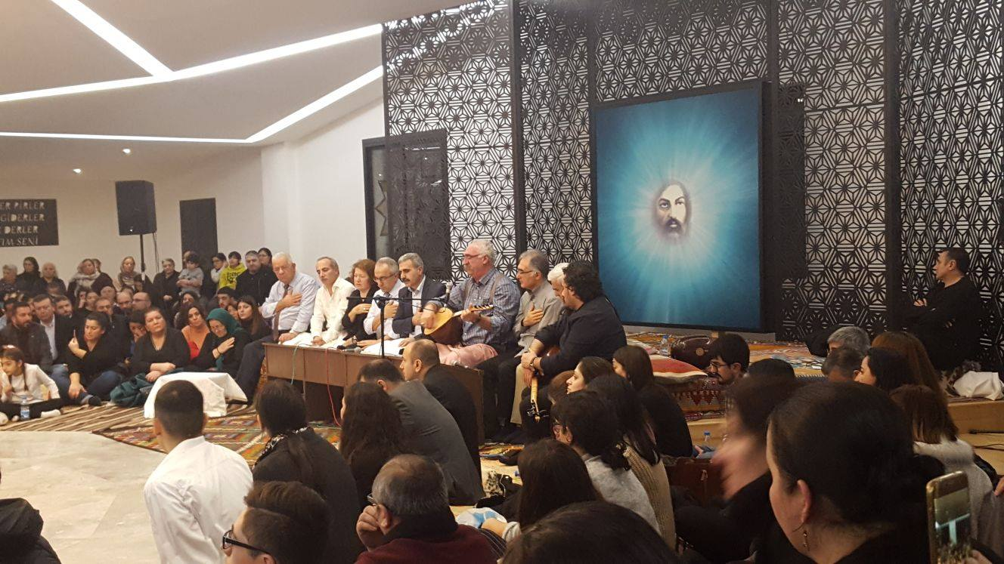
The Cemevi
Ancient Anatolian Cemevi (13thC)
Philip Andre
The Cemevi is the place for Alevis to come together and worship. This ceremony is called Cem. If possible everyone will sit in a circle facing each other.
Why do you think they will face each other?
What do you think this shows about their beliefs about people?
Modern Cemevi in London (2018)
Notes:
2. The first picture is of an ancient Cemevi in Turkey built in the 13thC.
The second is a modern Turkish Cemevi recently built in London.
Link this to the belief that Hakk is in everyone and therefore on equality and sharing. People sit together, facing each other and get involved in various ways. A good link to their experience iscircle time.

Slide 3
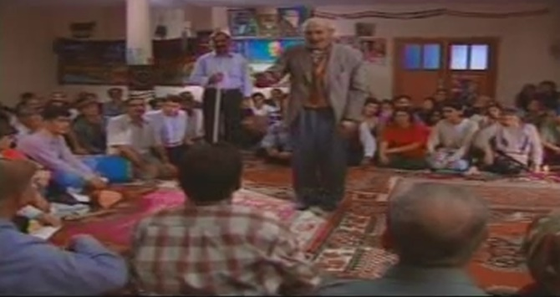
The Cem is the place for Alevis to share their acts of kindness, happiness, sadness, worship and equality.
Everyone is equal in the Cem. Those hurt and upset with each other will be reunited and wrongs will be resolved.
Notes:
3. The picture shows a man resolving an issue with the aid of the Dede and the whole community. The process involves being honest with yourself as well as with others and is not always easy. Such conflict resolution enables the community to work well together. It also helps people to try to be the best they can be.
Why is it important to resolve conflicts in a group?
How do you resolve conflicts?
Link to pupils’ own experiences of arguments and conflicts with their friends, in school and possibly at home. Explore feelings, contexts, needs and ways of making up with others.
What would happen if conflicts and disagreements weren’t sorted out?

Slide 4
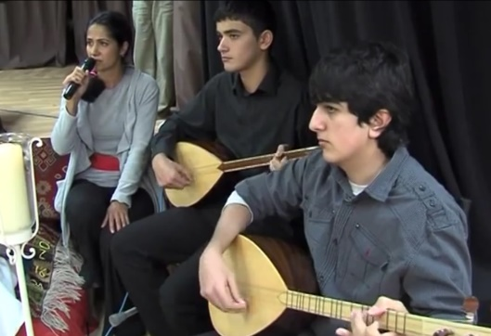
Candles will be lit, and using the “holy book with strings”, which is another name used for the baglama/saz (stringed instrument), the prayers, hymns, sayings, and poems will be performed.
Notes:
4. Explore the symbolism of light (knowledge, good, enlightenment, God)
Usually three candles are lit – Hakk, Muhamet and Ali.
Explain that for Alevis, there is no Holy Book (unlike eg Christianity, Islam, Sikhism) but the teachings and beliefs are expressed through the music, poetry and hymns with the saz.
What do you think ‘holy book with strings’ means?
So how important are the hymns and poems? Why?

Slide 5
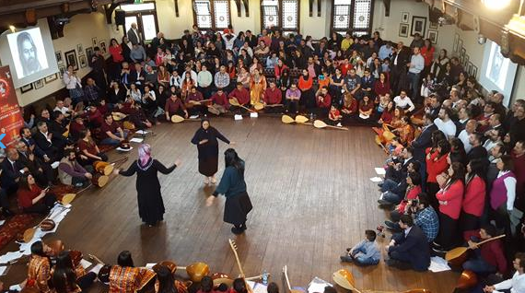
Semahs will be danced and people who are oppressed by others will be remembered. In the circling of the Semah, the dancers feel at one with each other and with Hakk (God)
Notes:
5. There are two elements to this and you may want to focus carefully on how you explore this with children.
The first part of this is that through the music, poems and movements of the semah, the dancers have deep feelings of becoming one with Hakk/God and each other. They become immersed in the dance in a way like children can become immersed in a story. This helps Alevis experience the equality and unity of all humanity as expressions of Hakk. The words of the hymns and poems remind them of how they should live, whilst the music and dance engage them more deeply as a group in the feelings and attitudes needed to become the best they can be. Imagine a birthday party in which people only SAID happy birthday as opposed to one where everyone sings it together.
Linking to oppression may be more difficult. Link to bullying and also to supporting the under-dog – helping those who are suffering. Bullying is an abuse of power in a relationship and is a form of oppressing someone that they can relate to.
What does ‘oppressed’ mean?
Alevis believe we are all equal.
They believe there is a bit of Hakk in everyone.
How do they show this in the Cem? (Semah, 12 Services)

Slide 6
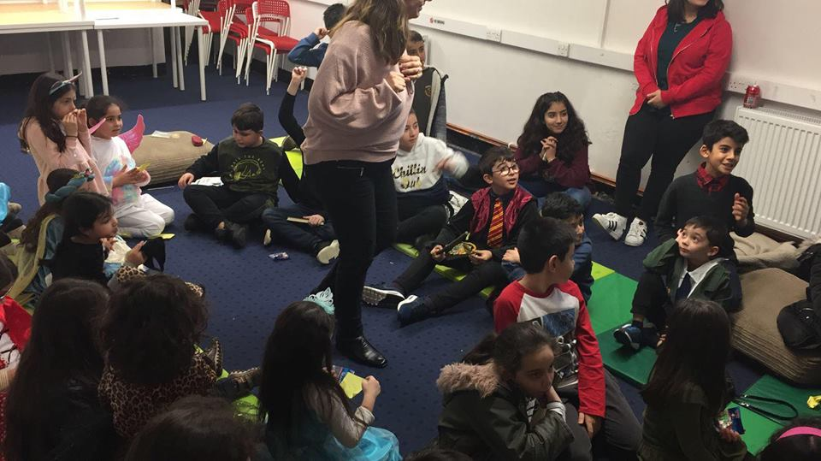
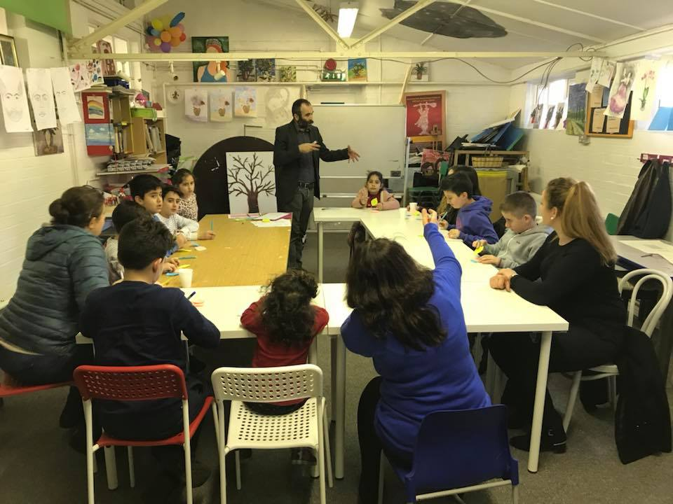
In today’s world, most Cemevis are also used as education centres.
Notes:
6. Hace Bektash Veli, the 13th C founding Saint (Pir) of Alevism, said that ‘the end of the path would be dark if the path is not knowledge (science).’ Alevis should be open, questioning and see themselves as on a continuing journey through life. They should not accept claims of truth that have not been justified (through reason) or evidenced (through experience) and they should stand against falsehood and lies. It is fair to say that he would not have been a fan of fake news!!!!
Knowledge and education are very important for Alevis. God is known as Hakk (Truth) after all! They encourage their children to learn and to question.
Education and learning are important in Alevism and so the Cemevi is also used to help children learn, not just about their religion and culture, but also (especially in Europe) to help them with their school work. Thus, for example, there will be extra catch up classes for maths and Literacy.
You might explore with children why learning and education are important not just for jobs but also for growing as, and becoming, a better, person. We don’t just learn facts, we also learn values – rules and ideas to live by.

Slide 7
Task
What would you expect to see at the Cemevi?
What more would you like to know about Alevism?
Make a list of questions that you would like to ask at the Cemevi.
Notes:
7. This task can be done in small groups, pairs or individually, or a combination of these. You might develop a ‘question wall’ with a picture of or from a Cemevi and the pupils’ questions around it.
Encourage pupils to ask deeper questions exploring not just the ‘what’ and ‘how’, but the ‘why’ and the significance, meaning and impact – the ‘so what’ – of what they are learning. If you use Philosophy for Children (P4C) you might use some of the techniques there for developing deeper questions.

Slide 8
Visit to or clip of Cemevi
Was there anything that puzzled you?
Are there any questions about what you have seen and heard that you would like to ask?
Notes:
8. If you can visit a Cemevi, this will help bring it to life and allow for encounter between pupils and the Alevi community. If not, try to invite an Alevi in to answer questions and respond.

