Slide 1
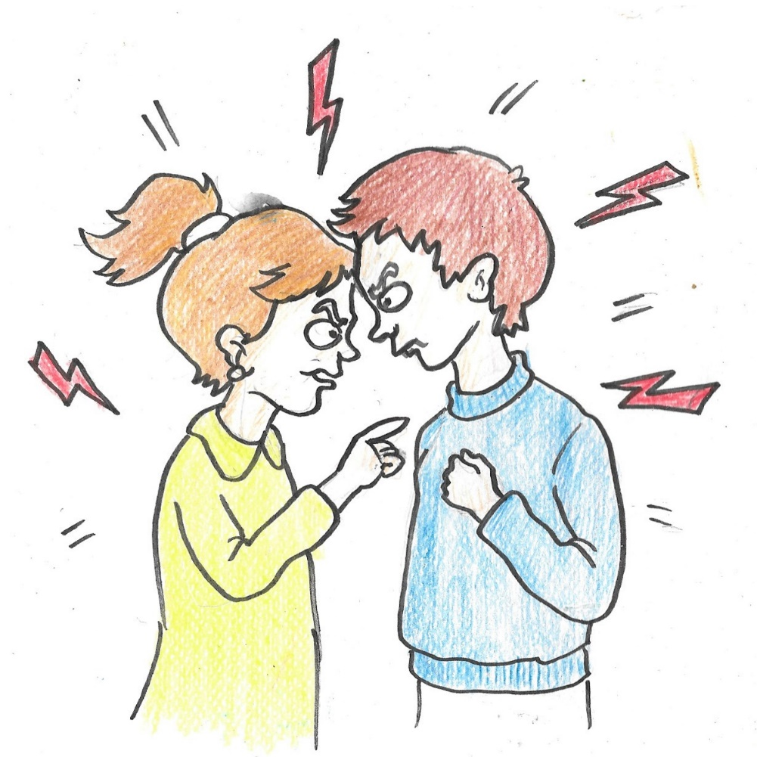
LO: I can understand how the Cem ceremony helps Alevis to resolve problems.
How does the Cem ceremony help Alevis get on with each other?
Everyone has disagreements and arguments!
Think of a time at school when you have had a falling-out with friends at play time.
How did you feel at the start of lesson? Could you concentrate on learning?
Sometimes we feel so bad we have to try to make up before we can concentrate on anything else.
Notes:
1. In discussing these, raise such questions as:
What kinds of arguments do you have? Who with?
What causes them?
Does getting cross help?
How do we sort out arguments at school? At home?
Who helps us sort out our problems? Noting that it is not just adults, but also our friends! Circle time?

Slide 2
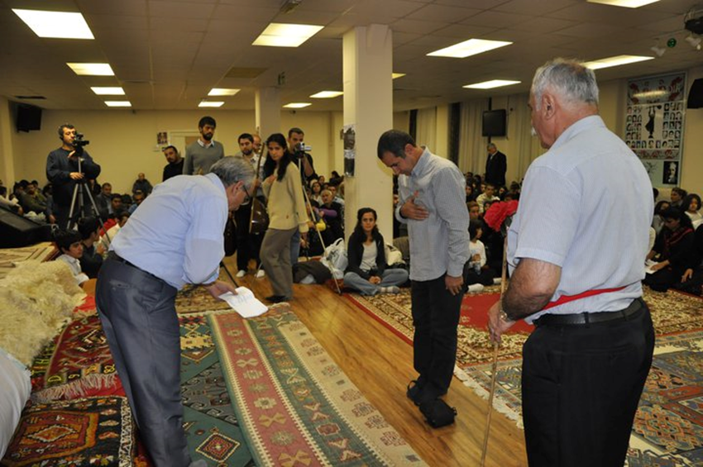
How do Alevis sort out their arguments?
Sometimes adults need the help to sort out their arguments, too!
Alevis may ask for help from the Dede or Ana to solve their problems before a Cem ceremony actually starts. This is called ‘resolving conflicts’
This is what is happening in this picture.
The whole group is involved!
Notes:
2. Ask why it is important to sort out our differences. Link it to their learning. If they have had a big argument or flight at break time and they still feel angry, does this get in the way of their learning? This then moves into ways that we resolve conflicts at school.
If there is a problem at school, you can’t concentrate on your lessons so the school staff try and help sort out the problem before the lessons begin.
This is similar to preparing for the Cem. People cannot worship properly if they still have bad feelings about others in the room. So they can sort out their problems before the Cem ceremony fully starts.

Slide 3
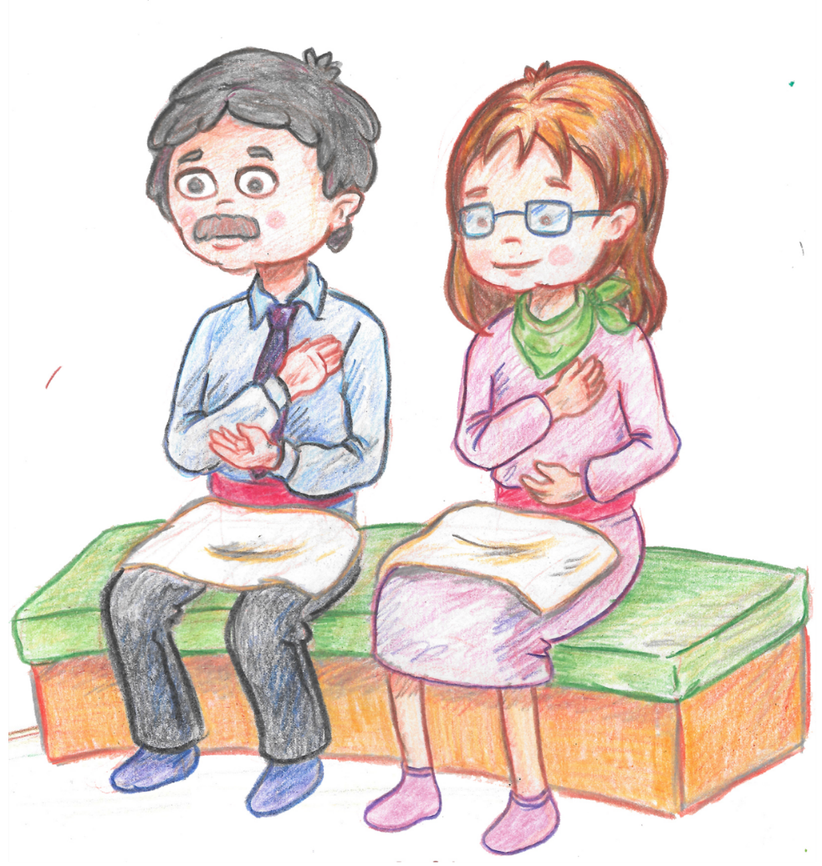
What does a leader do?
Dedes (male) and Anas (female)
are the religious and community leaders.
They lead the Cem ceremony.
But they also are leaders of the Alevi community and very respected.
They are experts in Alevi worship, values and wisdom.
Their advice is always listened to.
Notes:
3. Some background for the teacher in case the pupils ask!
The Ana/Dede role is passed on through lineage, ie birth, and the families trace their origins back to one of the 12 Imams. They are brought up into that role by their parents and the community and are educated in the traditions of Alevism. On the whole, they do not see their role as dictatorial, but as inclusive and supportive. Before the Cem ceremony the Rehber (guide) will get the consent of the people to allow the Ana/Dede to lead the service, so this ensures s/he is someone whom the people trust and value.

Slide 4
What qualities do you think an Ana and Dede will need to have? Why?
The Ana/Dede is the leader of their Alevi community.
What kind of people do you think will make a good Ana and Dede?
Notes:
4. Tease out the kind of qualities someone would need for others to go to them for help and advice – maybe linking to what they think a good teacher would need to be like for children to trust and learn from them. What makes a good leader? Particularly draw out that they need to listen to, respect and want the best for the people and not be arrogant or selfich. They need to live out and exemplify the Alevi values, especially that Hakk is in all people.

Slide 5
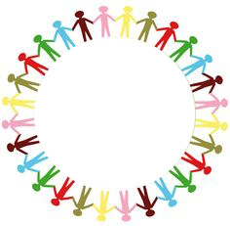
Circle time: resolving conflict
What makes me angry?
How does this affect my behaviour?
What do I do to make up with a friend?
How do I feel when we have made up?
Notes:
5. In running this circle time, remind the class of Alevi values, expressed in body, hands, mouth, as the ground-rules for the activity.
Clarify with the class what ‘resolving conflict’ means.

