Slide 1
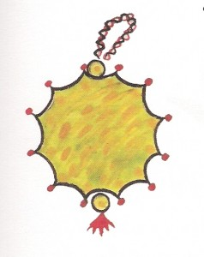
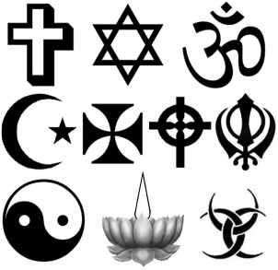
How does Alevism promote respect for and understanding of others?
Look at the religious symbols on the right. Which can you recognise?
Think about what you know about one or two of these faiths.
In groups, quickly share what you think Alevism has in common with some of these and also how it is different.

Slide 2
Alevi perspective on other Religions
“The way to reach Hak is many,
but there is only one Hak”
What does this mean?
“Religion is many, but the creator is One”
Haci Bektas Veli
What do you think the Alevi attitude to other religions is? What makes you think this?

Slide 3
Watch this short video-clip and think about what it means for Alevi attitudes to other faiths and beliefs.
http://www.youtube.com/watch?v=tRXblKUGl2k
Using the sheet with the 40 ‘values’ from last week, highlight all those which would expect people to respect and tolerate different faiths.
In groups, agree what you think are the three most important of those you highlighted.
Share as a whole class and discuss.
Notes:
Play clip from 0:00 to 1:20
The Alevis believe that there are many ways that you can serve Religion and God, i.e some might do it in a church, cemevi, synagogue, mosque or temple but we have to remember that:
The way to reach the “Truth/Hak/Allah/God/Yahweh/Vishnu/Budda”
May be many, but there is only one Hak/Truth
And Alevis achieve this by Essential self/Perfect understanding, tolerance and serving humankind
Question:
“Why should we not be prejudice towards other religions?

Slide 4
I am the Truth
Alevis believe the purpose of life is to become one with God.
“If god created every living thing in the universe, then there is a piece of God in every living thing, including humans, animals, plants, air, water, earth, you and me, so to describe God as separate from us would be wrong for all creation is part of God;
therefore I am one with God”
Hallaci Mansur (858AD to 922AD)
‘To respect and serve man is the essence of worship for Alevi’
Notes:
Explain briefly about the ‘Perfect Man’ in the heart of every person, and that if every person is an expression of Hak, then we have a duty to serve each other as we serve ‘Hak’.

Slide 5
Alevi Message “Tolerance”
Alevi doctrine says you have to be tolerant and loving towards all
people no matter what their religious beliefs are.
To be tolerant doesn't mean to embrace your neighbor's religion, but
to respect him for what he is, a human being created in the image and
likeness of God.
Notes:
Read the box above
Now ask:
What is tolerance and why is it important?

Slide 6
The ‘Golden Rule’ in all religions
Look at the sheet on the ‘Golden Rule’. What do you notice?
If the religions all have this ‘golden rule’, then why do you think many persecute others?
Despite being persecuted a lot themselves, Alevi have not been known to persecute others. Why do you think this might be?

Slide 7
Over to you! Where do we get our values from?
Family
Community
TV
Tradition/history
Faith
Friends
Role models
Worship
Songs/Music
Stories
Internet
Other??
Which are most & least important to you? Why?
Which do you think might be most & least important to Alevi teenagers? Why?
Use pages 3-6 of the identity booklet to write your ideas
Notes:
Discuss this briefly as a plenary. Encourage the students to think deeply about this, maybe sharing ideas. The homework is to get them to write their thoughts on the pagesmentioned, but emphasise that these might only be very rough ideas and there are no set right answers. Emphasise the word ‘might’ in qn 2!

