Slide 1
Is Alevism a sect, a religion or a code for social living?
Evaluation and final reflections

Slide 2
Over to you! Where do we get our values from?
Family
Community
TV
Tradition/history
Faith
Friends
Role models
Worship
Songs/Music
Stories
Internet
Other??
Which are most & least important to you? Why?
Which do you think might be most & least important to Alevi teenagers? Why?
Use pages 3-6 of the identity booklet to write your ideas
Notes:
Discuss this briefly as a plenary. Encourage the students to think deeply about this, maybe sharing ideas. The homework is to get them to write their thoughts on the pagesmentioned, but emphasise that these might only be very rough ideas and there are no set right answers. Emphasise the word ‘might’ in qn 2!

Slide 3
Two main figures of Alevism
Hünkar Bektaş-i Veli (1281-1338)
Founder of the
Bektaş-i lodge
St. Ali (601-661) is the first imam of 12 who are sacred persons in Alevism
Notes:
Introduce these to show that the roots of Alevism are complex. You can remind students of the statements about Ali and humanity in the ‘basic beliefs’ sheet.

Slide 4
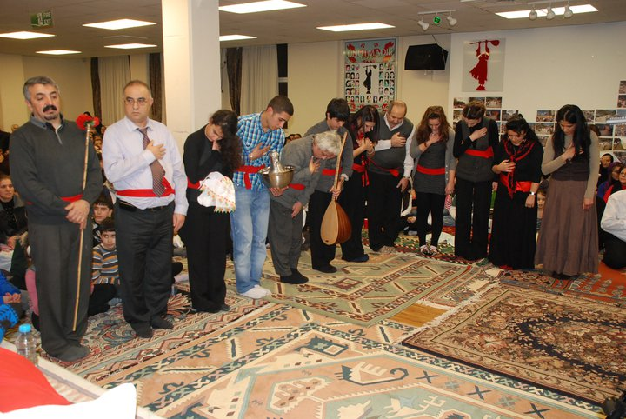
The Truth
Cem ceremonies are held to reach the ultimate Truth by serving others.
The truth is one but ways to it are many
Alevis know this and accept all religions.
Notes:
READ THIS
CEM Ceremonies are held to reach the ultimate Truth by serving others.
The truth is one but ways to it are many
Alevis know this is why they accept all religions.
How do you know what is the truth? How do we judge when someone is telling the truth? Is the truth knowable?

Slide 5
Peace
“Peace outside can only be reached
through peace within”
Haci Bektas Veli
This is the teaching of all saints:
“in order to achieve peace you must first conquer your own anger and the bad within yourself”
What does this mean? Do you agree?
https://www.youtube.com/watch?v=lZzC1SKER8U
Notes:
Read the above
Then Play clip 02:42 to 04:00 MAYBE PLAY THE WHOLE CLIP AS IT HELPS EXPLAIN HOW CEM HELPS ALEVI LIFE THROUGH FAITH AND RITUAL
Then Explain the following:
Learn from your mistakes and be knowledgeable.
Don't look for lacks/faults in others.
Respect 73 Nationals/different people in the same way.
For God Loved and created, thus don't say anything.

Slide 6
Discrimination
Alevis have been discriminated against since the 16th Century.
more recently, by the Turkish Government in the 1970s, 80s and 90s.
In the 1990s, there were a few major incidents in which Alevis in Turkey were killed by Turkish people and the police did nothing.
Many Alevi families left Turkey in this time and settled in places such as Britain to escape persecution.
How can Alevi live out these values when they are persecuted? Brief discussion.
Alevi history is a history of “allegiance with the oppressed”.
Notes:
Read the box above
Then ask
Question?
Why should we not discriminate against others?
Alevis look at 73 nations of the world with the same perspective, they are taught to be just towards others and accept them as they are for they are the creation of God/Hak.

Slide 7
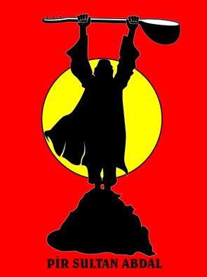
Alevism and other religions
What is your view on Alevi beliefs?
Is Alevism like other religions or not?
Now try and complete the last page of the identity booklet. Think carefully about who the Alevi see themselves as, and who you see yourself as.

Slide 8
What does it mean to be Alevi? | What does it mean to be me?
Imagine that you are a teenager from an Alevi family and complete the following: Four really important things to or about me: 1 2 3 4 Three trivial things about me! 1 2 3 What I really want out of life is… | What are my most important beliefs? How do these influence my life? Who is/are most important to me? Why? What is/are most important to me? Why What I really want out of life is…

Slide 9
We have really enjoyed working with you and we would like your feedback to see how we can improve this unit on Alevism
What have you found most interesting?
What have you found most difficult?
Was this unit worth doing? Why? Why not?
How could this be improved?
Any final comments or suggestions?
Thank you very much!

