Slide 1
Why is the Cemevi important to Alevis?
LKS2 LESSON 1
1. What is the role of the Cemevi?
Notes:
1. Ask the pupils to name different religious buildings they know of (eg church, mosque, gurdwara). Ask if anyone knows what the Cemevi is (note that it is pronounced ‘jemevi’)

Slide 2
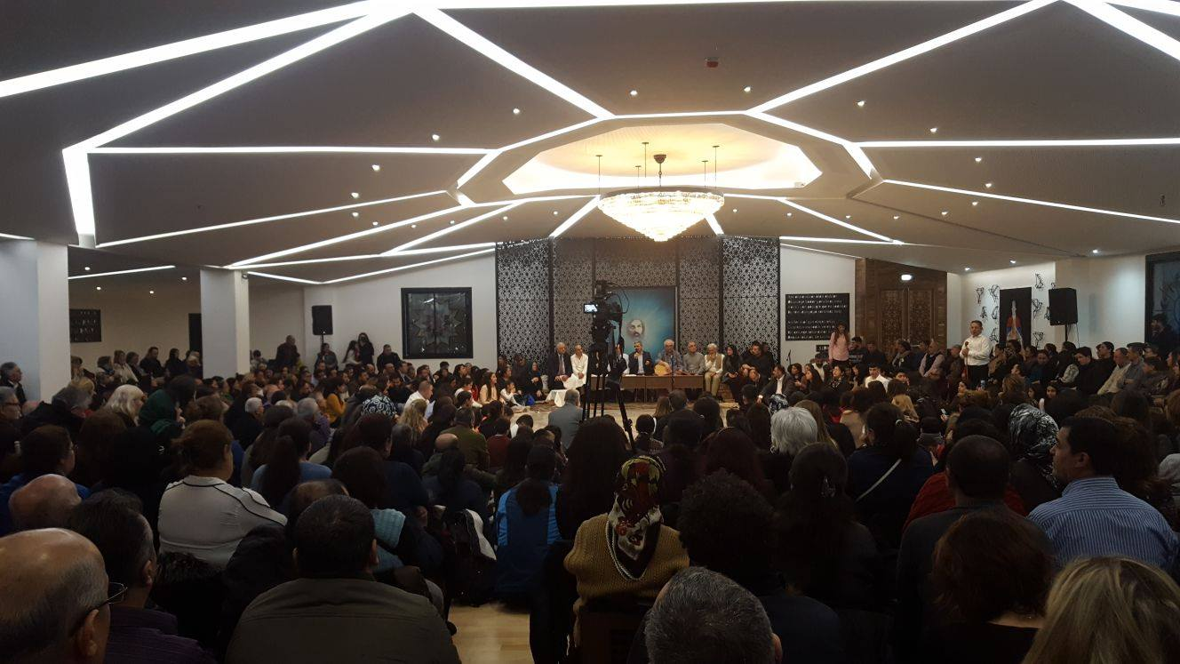
LO I can understand different ways the Cemevi is used by Alevis.
Notes:
2. Share the LO with the pupils exploring what this will look like – ie being aware of different uses of the Cemevi and also why these are important to Alevis.

Slide 3
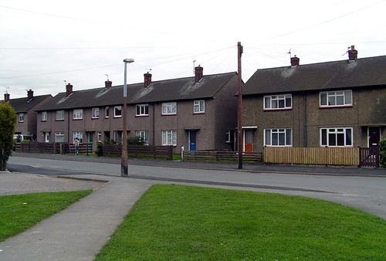
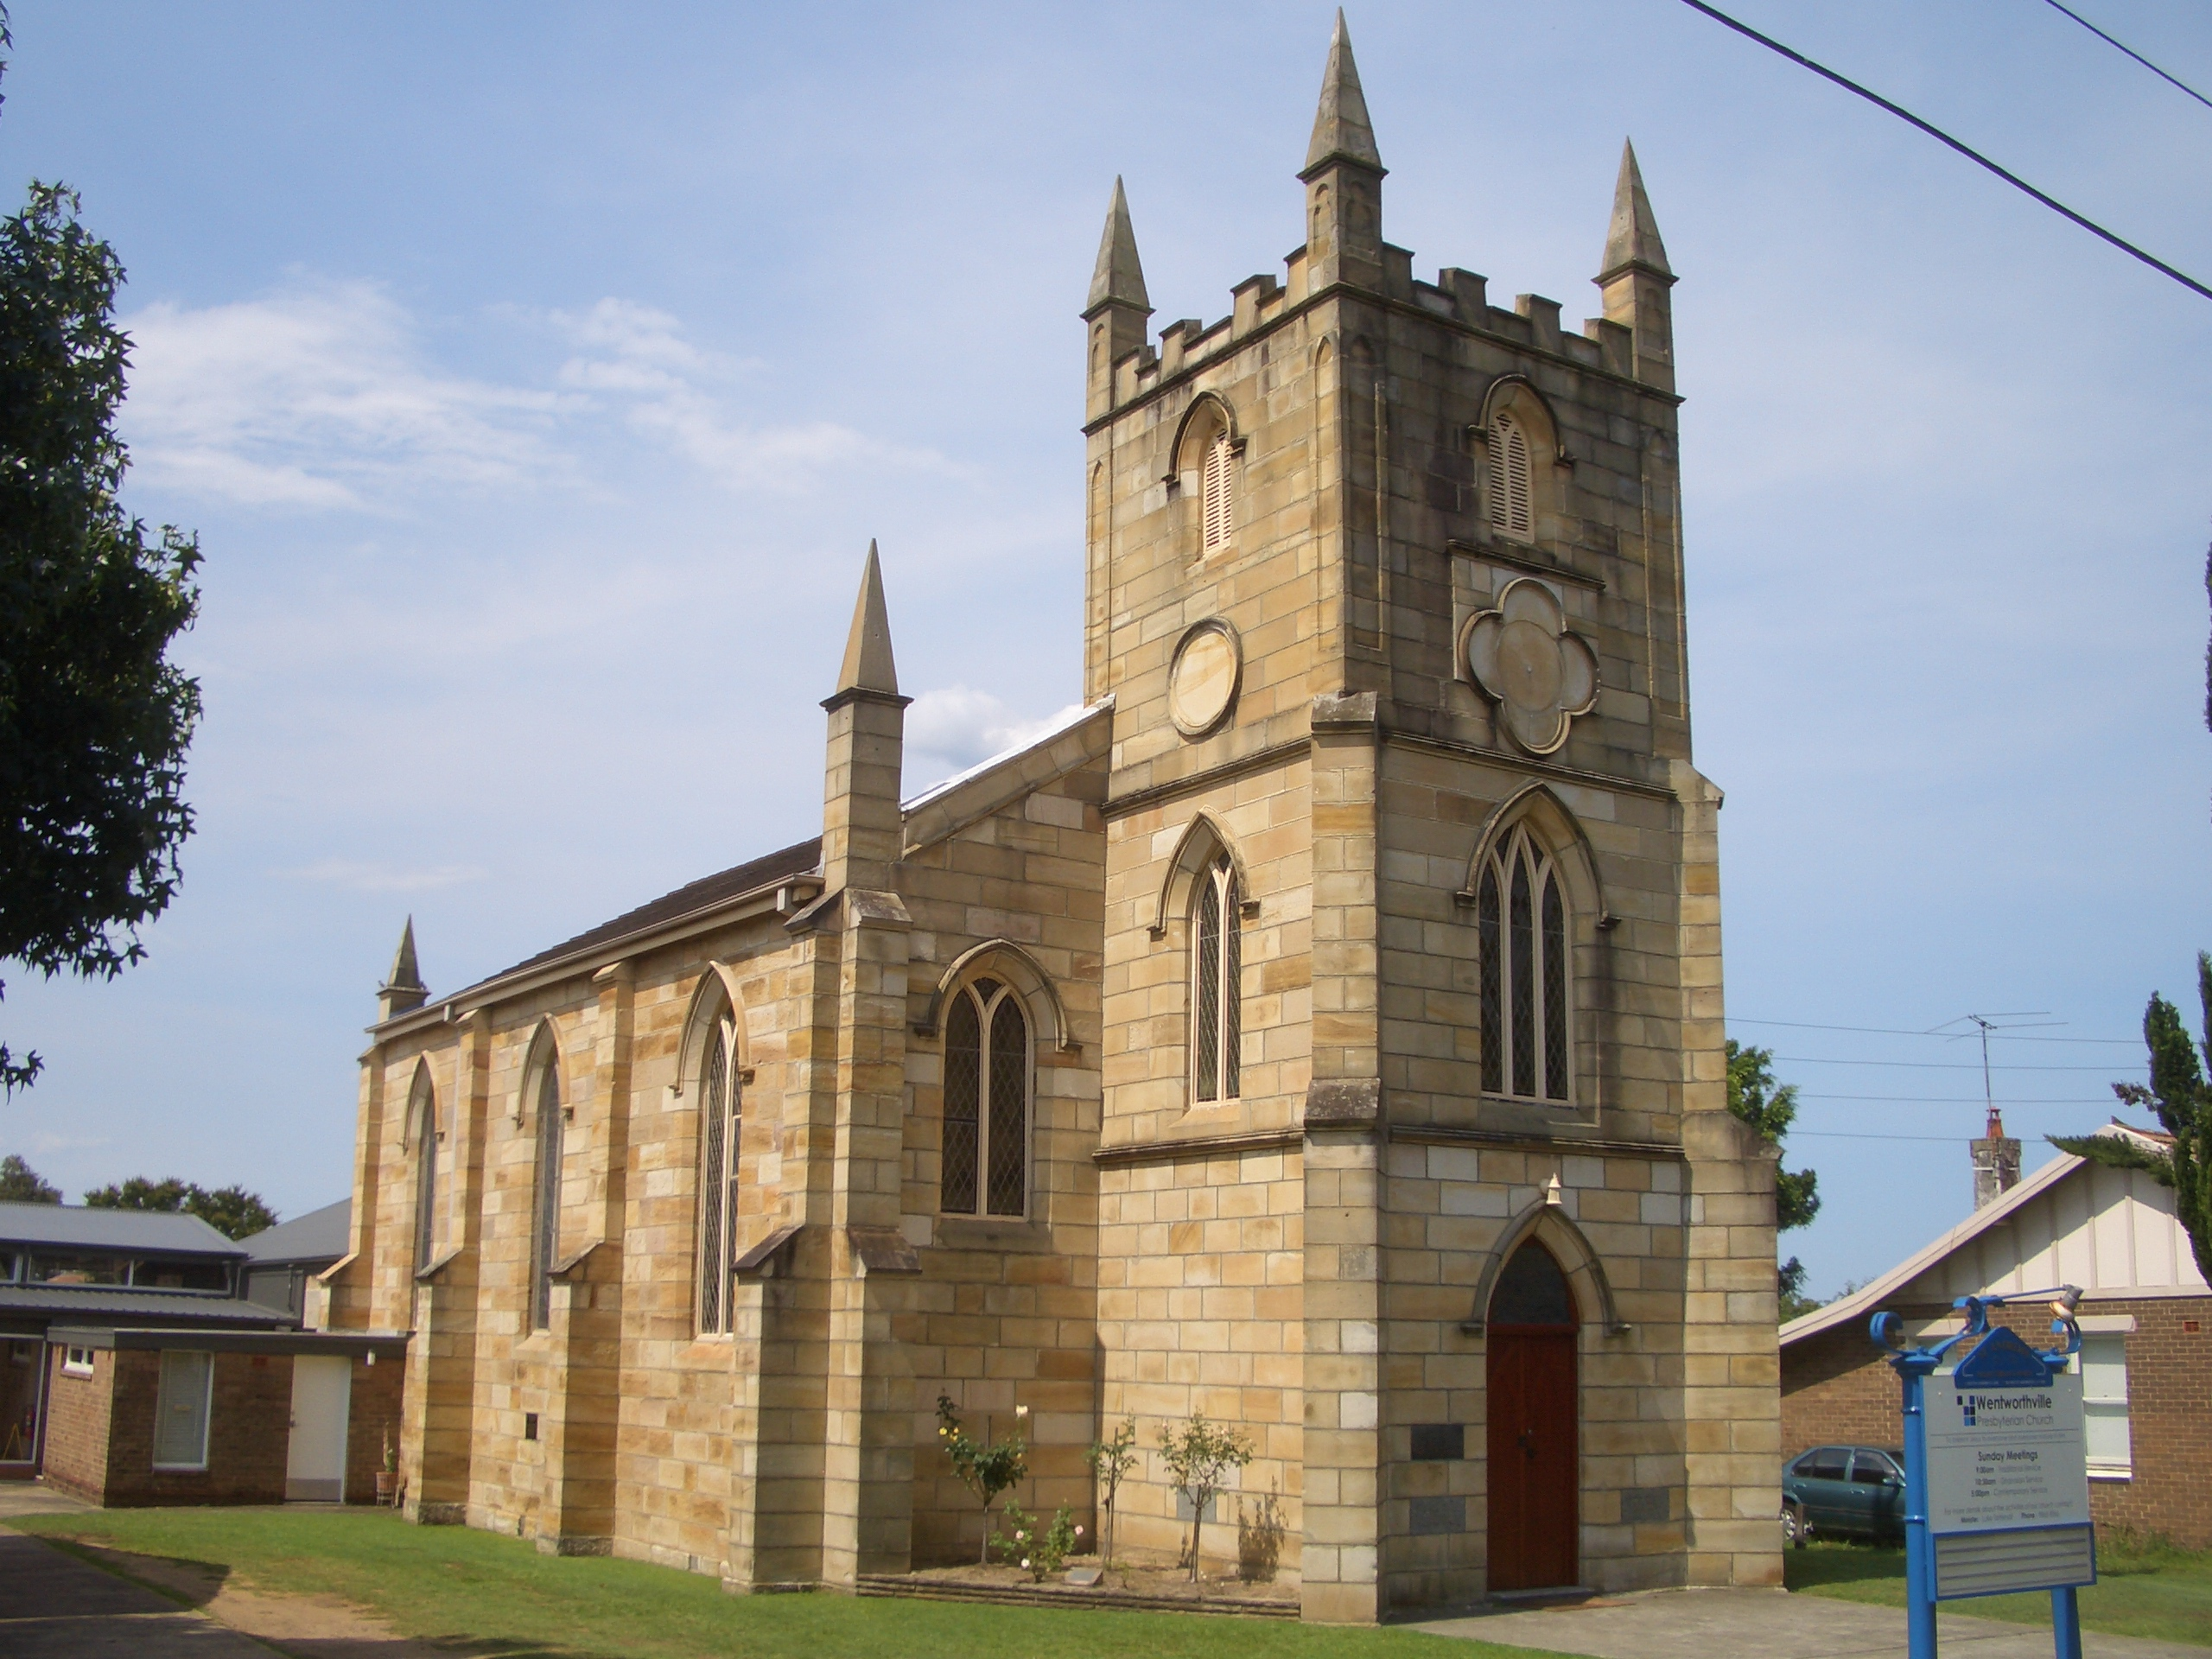
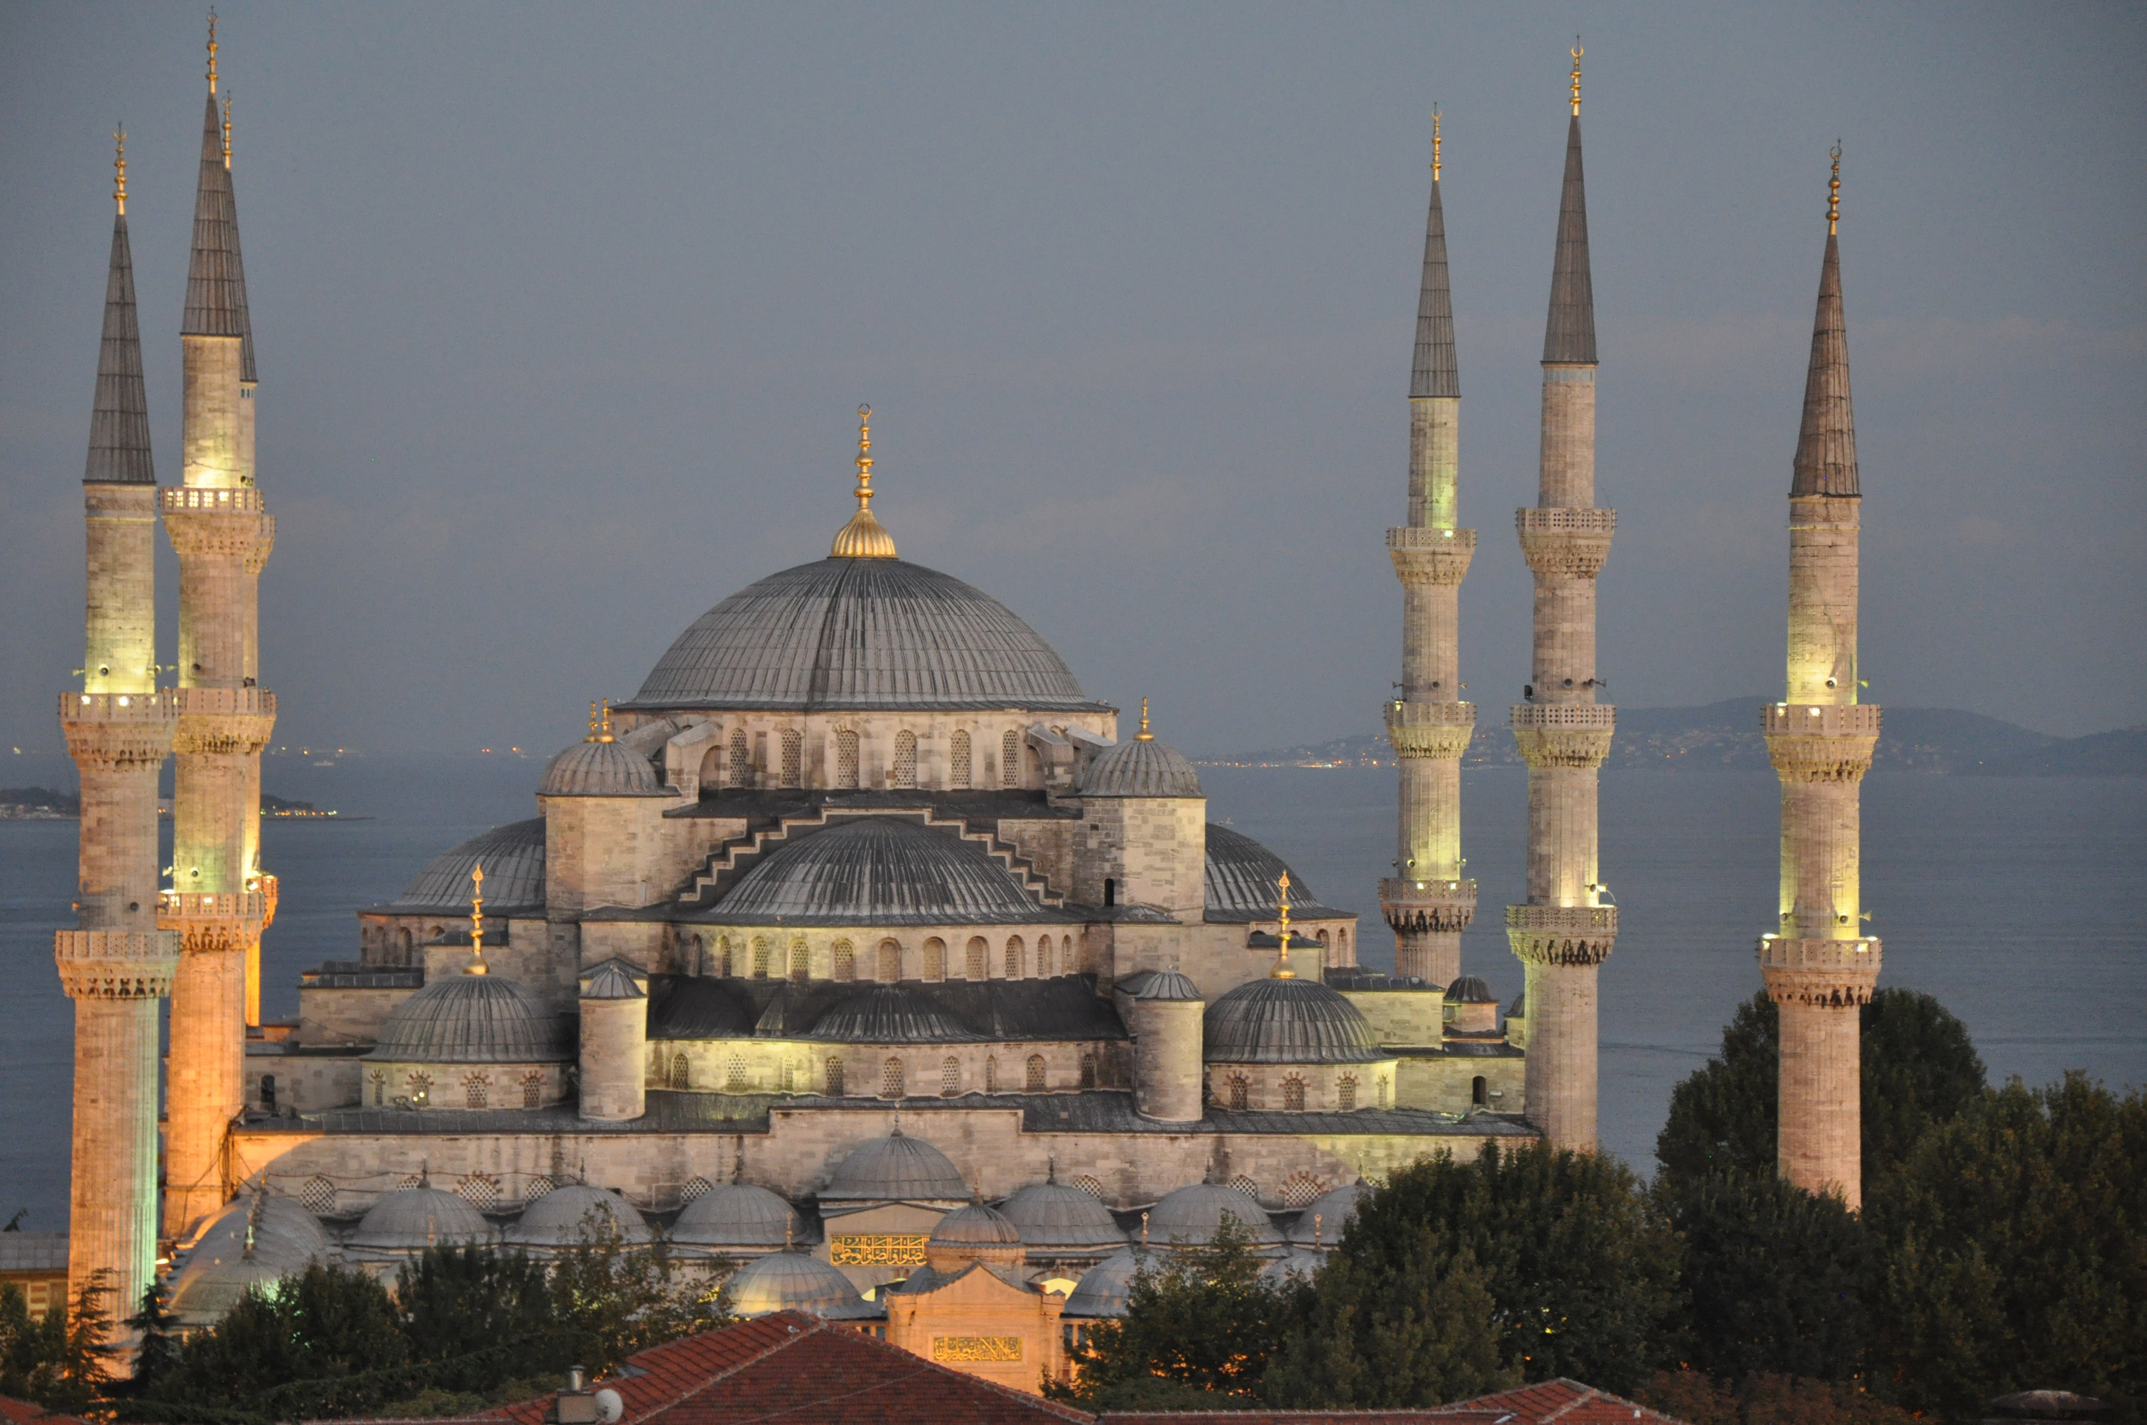
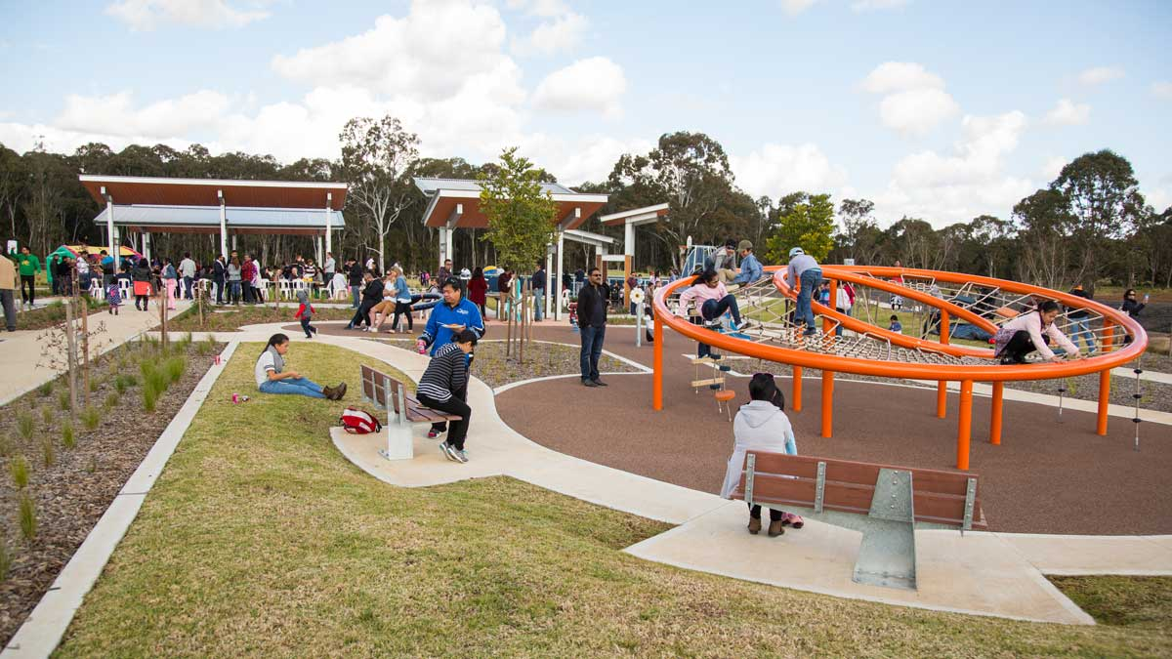
What makes a place special and important to people?
Look at these pictures and say what might make them important to some people.
Notes:
3. As you share these pictures with the pupils, ask them about the purposes of the places, what is appealing about them, any feelings and experiences , how or what it might get people to think, what features of the place that they notice.
For each one, come back to the question – what might make this place special or important to someone – or some people? Is there a difference between a place that is important to one person and more than one? What might make a place or building important to a lot of people? Look at developing the idea of sharing experiences, ideas and feelings; belonging etc

Slide 4
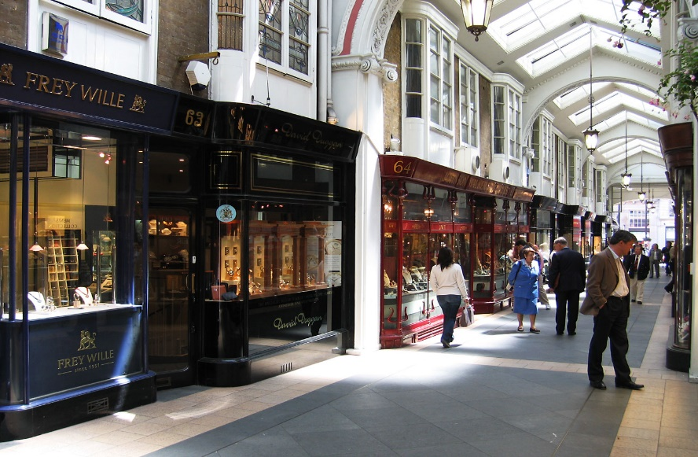
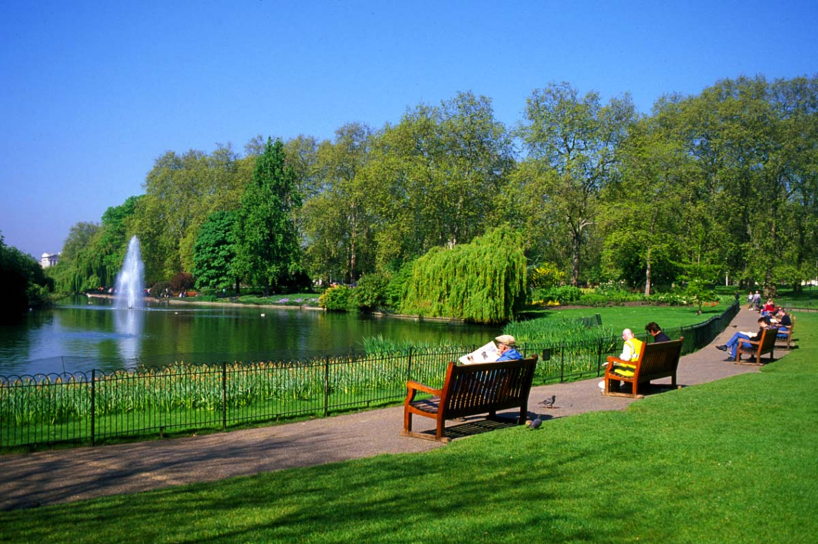
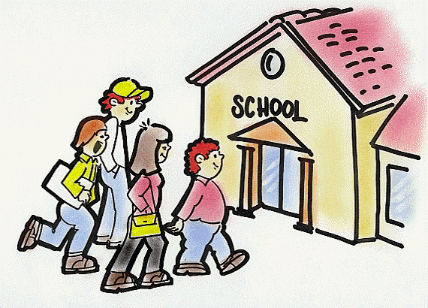
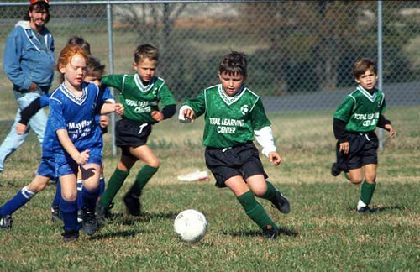
What places do you go to and why do you go there?
Notes:
4. Discussion in groups- places children go to e.g. shops, school, home, brownies, clubs, football clubs, music clubs. Get pupils to reflect on the purpose of each place and how the building helps to fulfil that purpose. Photos to help stimulate ideas

Slide 5
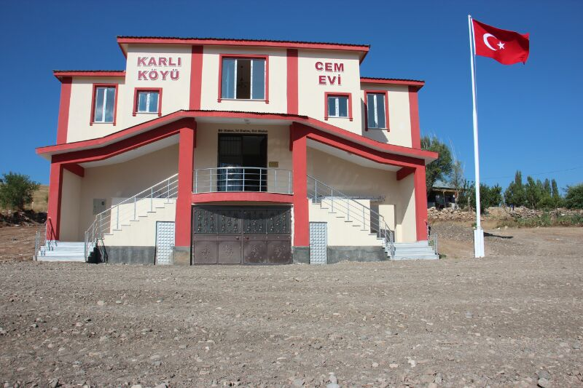
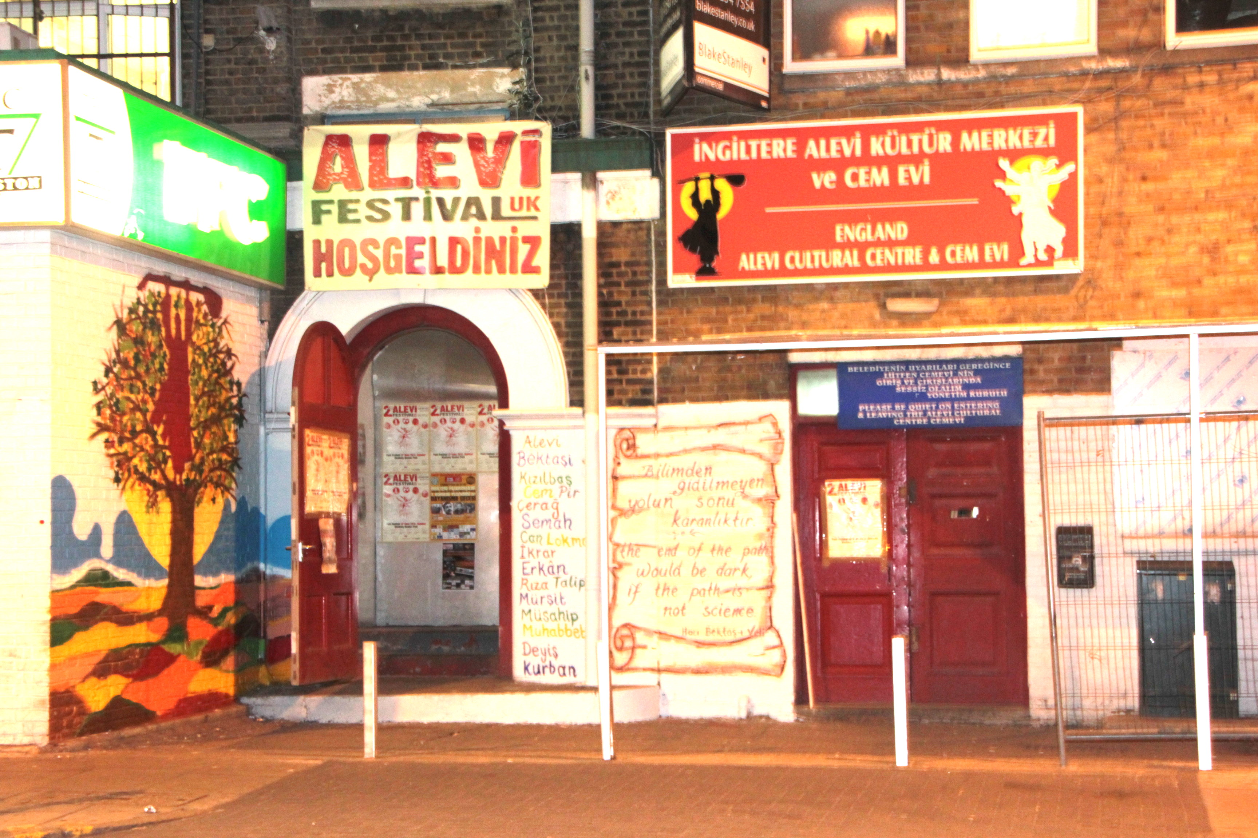
For Alevis, the Cemevi is a very important place.
Notes:
5. The Cemevi on the left is in Turkey and on the right is in London. The former is purpose built; the latter is a converted building. Does this matter? What do you think goes on in these buildings? What makes it a Cemevi – the shape of the building? The people who use it? Its purpose? What goes on in it? Is it more important to have a specially designed building?

Slide 6
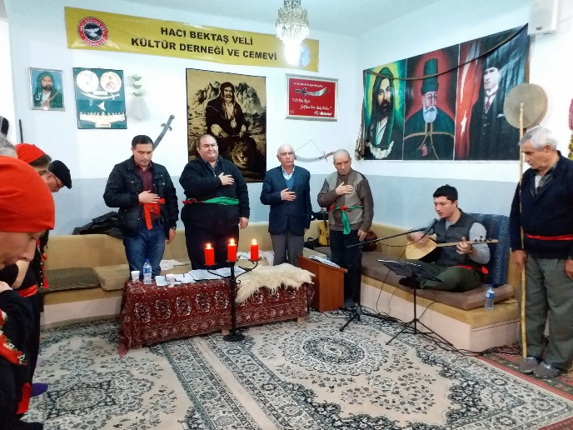
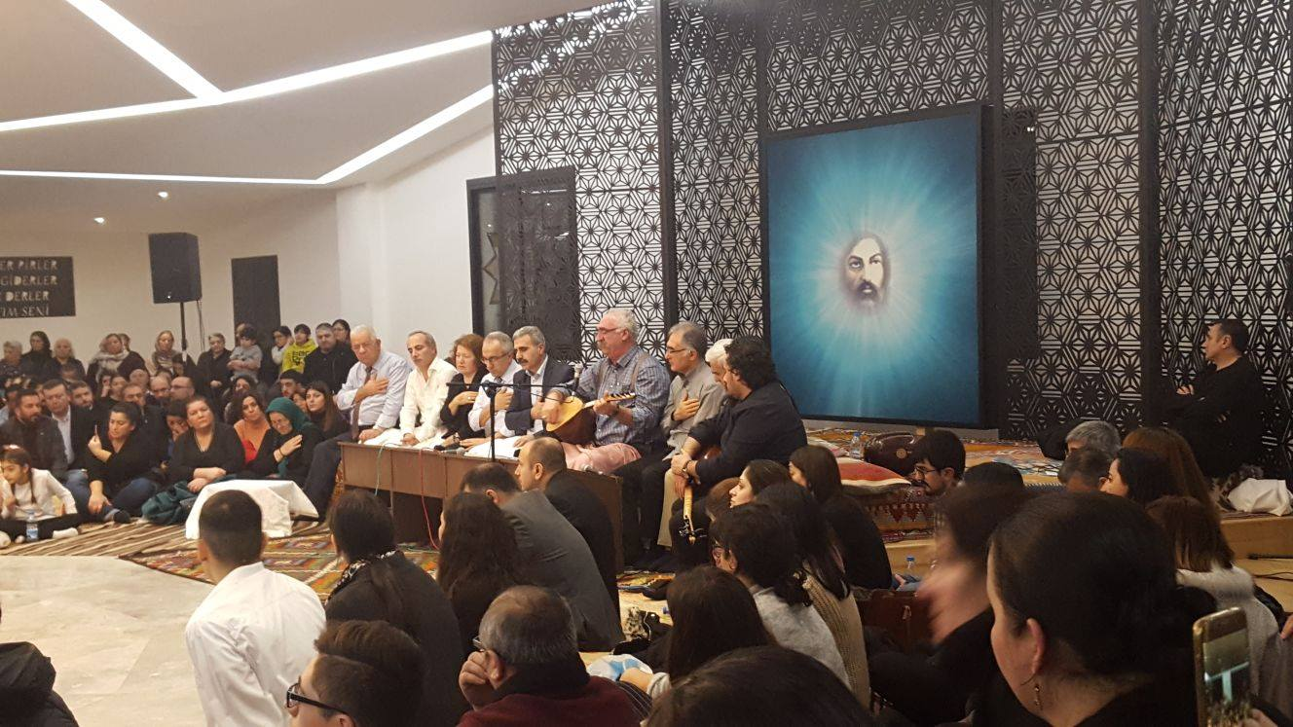
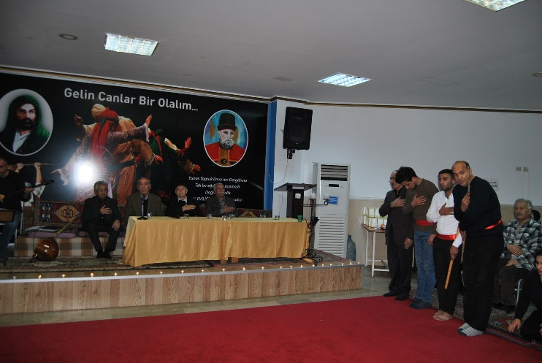
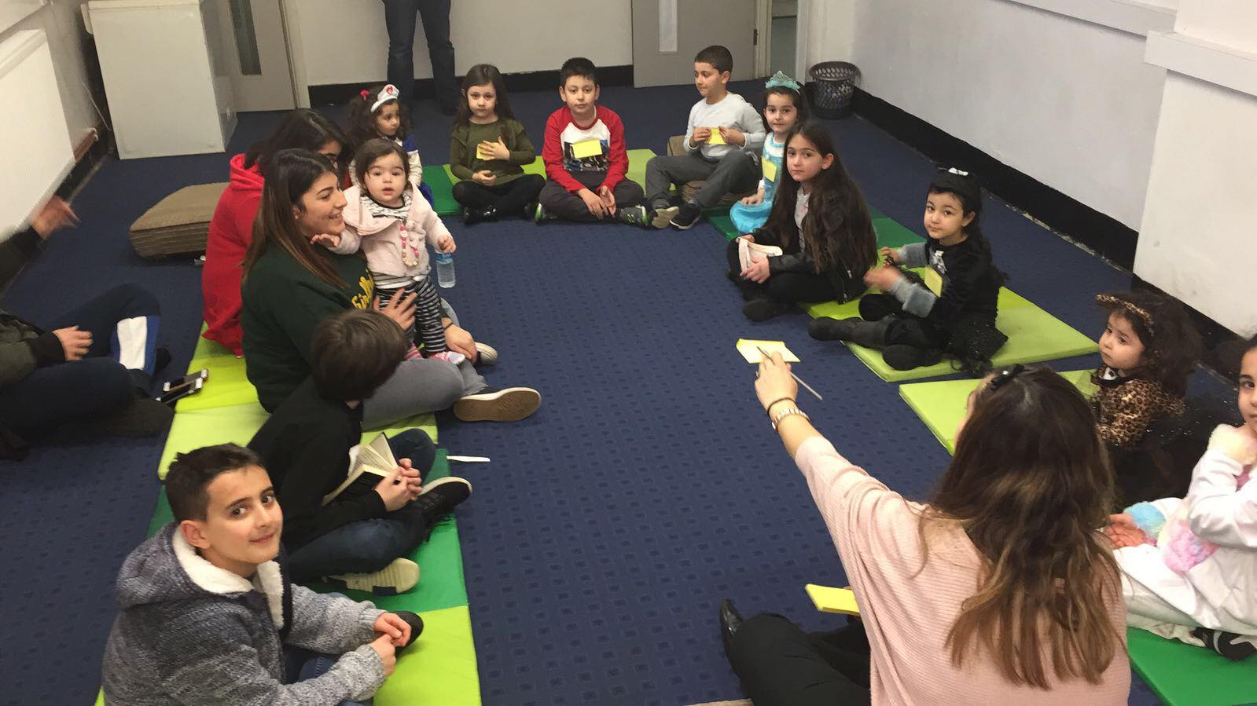
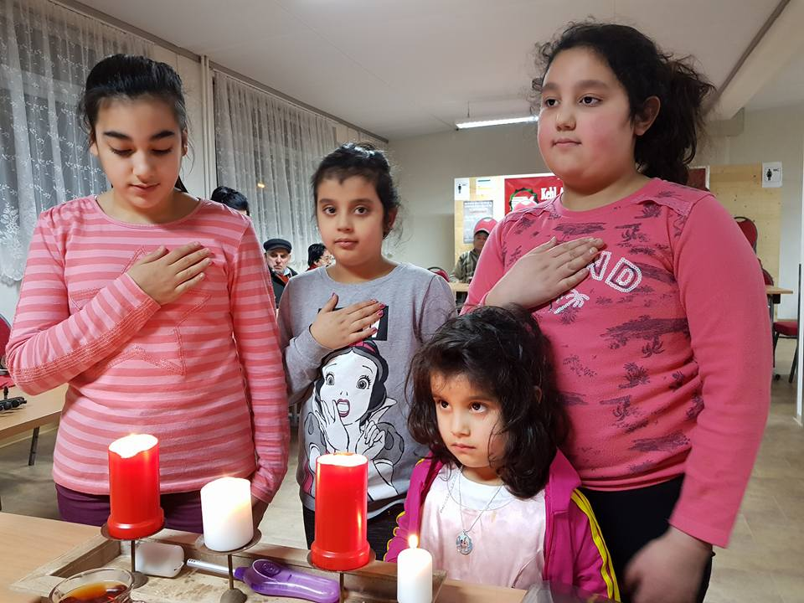
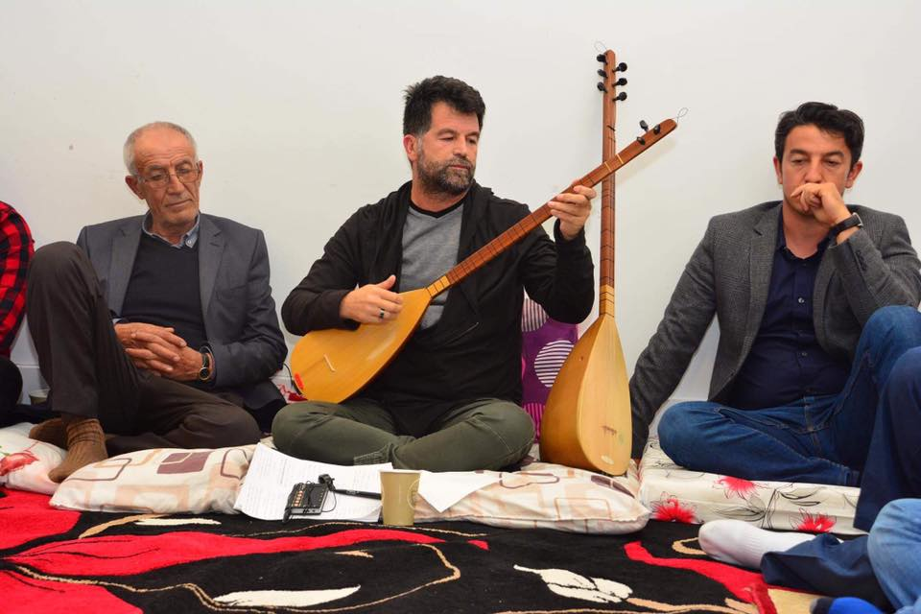
What do you see in a Cemevi?
Notes:
6. Explore with the pupils what these pictures show as FEATURES of a cemevi (eg puctures, no chairs, hall, small meeting/community rooms..) and how they might be important to or help the Alevi community. What might the big hall be used for? Why the carpets? Where are the seats? Why the pictures? Who might they be of? (Not names, just ‘important leaders in Alevism’ will do!)

Slide 7
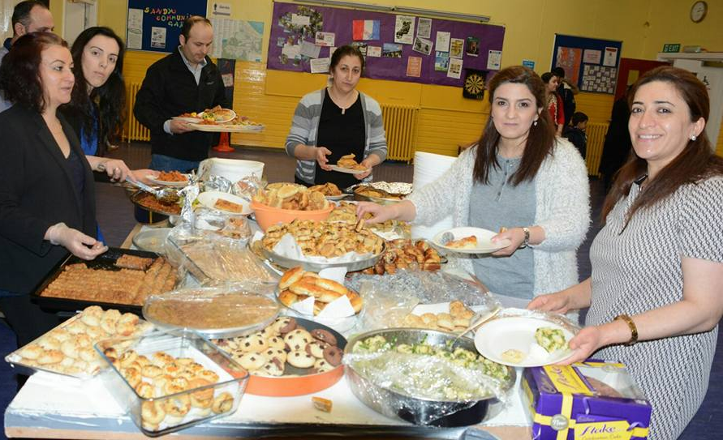
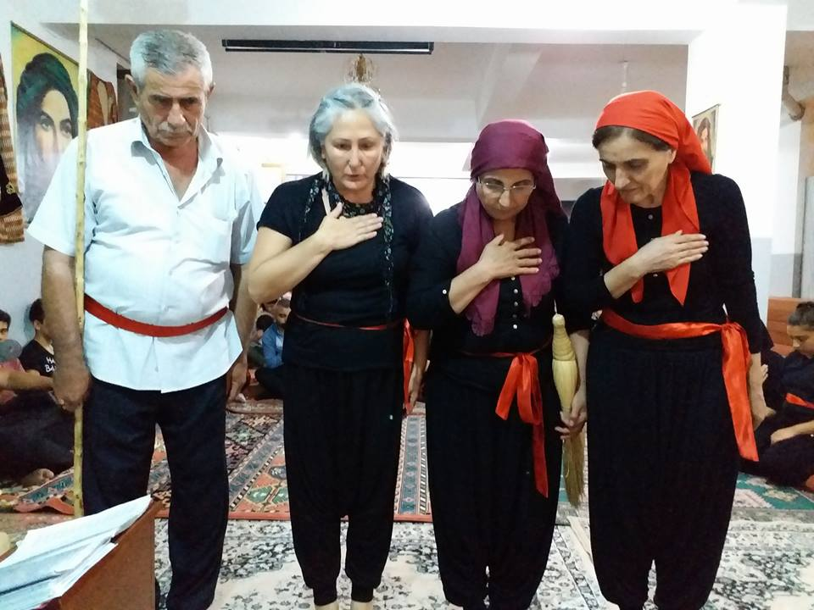
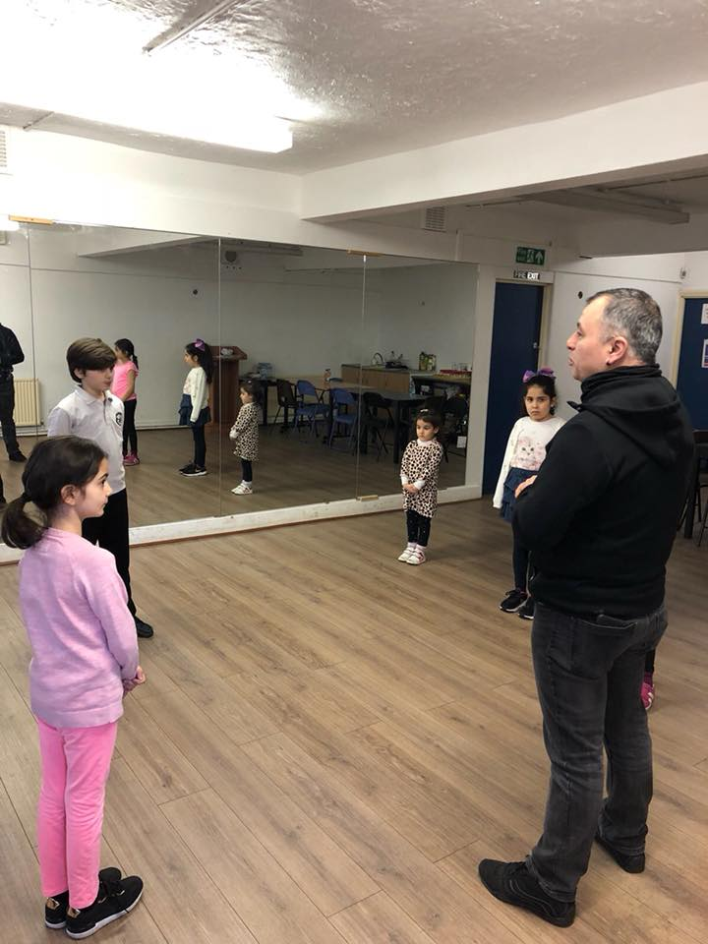
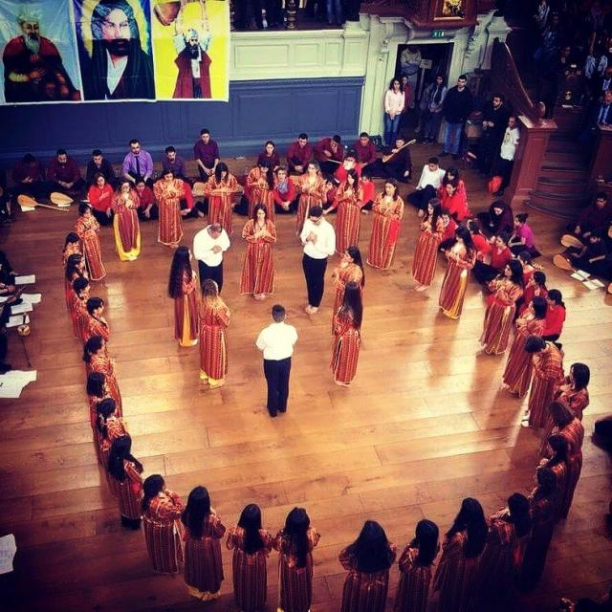
What is happening in these pictures?
Notes:
7. What is going on in these pics do you think? Why? What do they have in common? What do they notice? Does it remind them of anything else they know about? (responses could be worship, learning, circle time, sharing a meal etc)

Slide 8
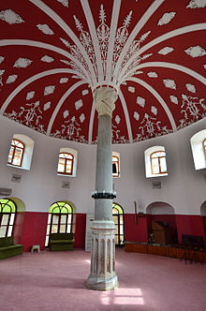
Task
Why do Alevis go to a Cemevi?
Feelings?
Beliefs?
Actions?
Sharing with others?
Notes:
8. Help children to recall and reflect on these aspects of what goes on in a Cemevi, using the headings to help stimulate thinking. We will return to this at the end of the unit. This should involve individual written responses, talk-partners and whole class discussion, but personal written work can come before or after oral work – or both! Eg In each case, get pupils to draw a symbol/picture to represent what happens in a Cemevi. Then to discuss with partner to answer why Alevis go to the Cemevi, writing a summary in a limited number of words – maybe something like a tweet? Share some with the class.

