Slide 1
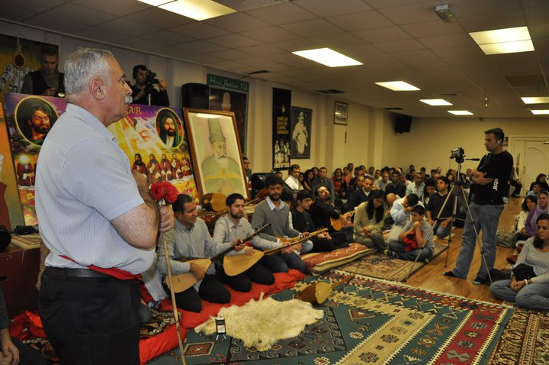
LO: I can express my views about Alevism in different ways.
What have I learnt about Alevism?
Notes:
1. For this lesson, it is best if you can either visit a Cemevi or invite an Alevi visitor, possibly a saz player, to work with and talk to the pupils. Make this as active and creative as possible, so that pupils are invited to role-play, write poetry, dance etc. Have saz music playing and if possible Alevi artefacts that you may be able to borrow from a local Cemevi.

Slide 2
What can you remember about Alevism from these lessons?
Notes:
2. Recap with the children and develop a class spider-diagram of Alevism from what they can remember, with each lesson being the main branches.

Slide 3
Which tasks can you do?
Act out some of the roles in the Cem ceremony.
Perform a Semah to some Alevi music?
Write a poem to show what you feel and think about what you have learnt?
Do some art to show what you feel and think about what you have learnt?
A mixture of these?
Notes:
3. Provide opportunities for pupils to show celebrate, enjoy and express what they have learnt!

