Slide 1
What is the meaning of Hakk and the importance of serving others?
Notes:
1. Ask children how they help others in the school, at home and elsewhere. Why do they do this?

Slide 2
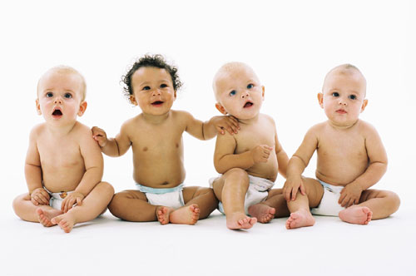
Alevis believe that God/Hakk is in all people
Hakk is the Alevi word for ‘God’. It means “Truth”.
So for Alevis, we are all special or ‘sacred’.
Do you think everyone is special or sacred? Why?
Notes:
2. Encourage the children to reflect on what this means.
Ask what help children need in order to get through life and who will provide that help.
Can anyone live through life without the help of others?
Do we have a duty to help ALL people?
What about bad people? Should we help only good people? Develop here the idea that all people have some good and bad in them. Whom should we help? (Maybe link to Good Samaritan if you have done this before.)
Imagine what life would be like if no-one helped others.

Slide 3
Because Hakk is in everyone, Alevis believe that we are all equal
Therefore, we should treat each other with respect.
This Photo by Unknown Author is licensed under CC BY-SA
Notes:
3. What do we mean by ‘We are all equal’? Is this the same as we are all the same?

Slide 4
How should we treat other people?
The way to do this is to wish for others what you would want for yourself.
‘As you see yourself, this is how you must see all other people.’
Remember, Alevis see Hakk in themselves and all people.
This makes a difference to how they treat people and how they behave.
This Photo by Unknown Author is licensed under CC BY-SA
Notes:
4. Encourage pupils to explore what the second bullet point means.
If we all have something of God inside us, what does that mean we should think about
Ourselves?
Other people?
(possible extension discussion to get pupils to think about authority and purpose in a community: Who is the most important person in this school?)
Get pupils to make the link with the Golden Rule (‘Treat others as you would want to be treated’). If there are children from different faiths and cultures, they may well know the version related to their belief and these can be shared and explored.

Slide 5
Alevis believe that God/Hakk is in all people
In the Cem ceremony this is shown in many ways.
The hand over the heart represents the presence of God/Hakk in the person.
Notes:
5. Look also at the seated people.
What do the body postures and facial expressions show? Explore this maybe through drama if there is time. Compare with opposite body postures such as arrogant (big-headed); angry; elated (excited and happy). Explore ideas such as humility, respect, thoughtful, serious…etc.
.

Slide 6
Roles and responsibilities in a Cem and at school.
There are 12 ‘Servants’ (volunteers) who each has a duty to perform.
Each has a role to play in the Cem.
Just as without teachers, pupils, dinner ladies, head teachers, cleaners, parents and teaching assistants the school would not work.
Each has a role to play. Each is important.
Let’s watch the video of a Cem ceremony
Notes:
6. Ask pupils if they remember any of this from KS1.
Explain we will now be asking some more difficult questions that they would not have been able to do in KS1 and may find challenging now.
“We will help each other out in our thinking and I am sure that you will all be able to respond to these harder questions.
Let us think and work together – does anyone know a good word meaning working together? Collaborate!”
As you watch the video clip, stop and discuss to help pupils, as described in note 7

Slide 7
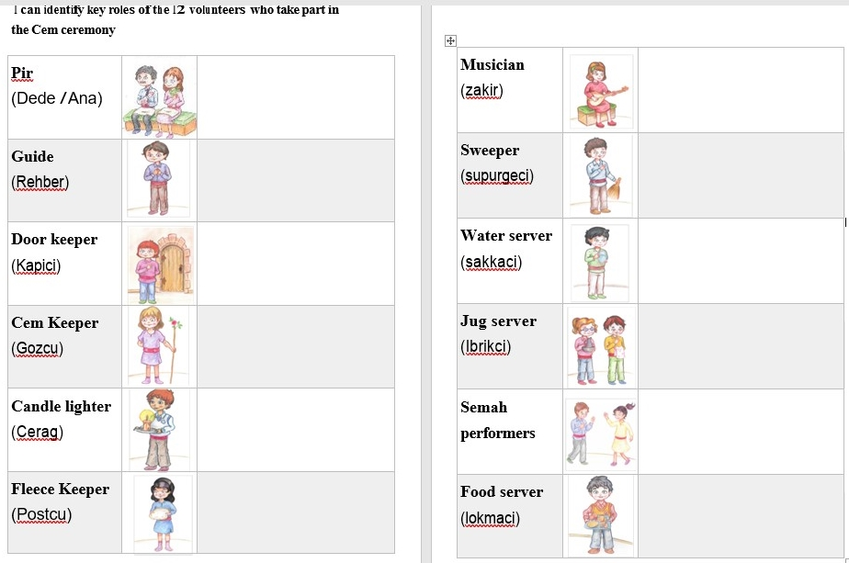
Notes:
7. This may be difficult for some chn. You will need to facilitate discussion and collaboration! You do not have to cover all 12 on the sheet – just focus more deeply on a few. Read the teacher notes for the 12 Services for your information.
It is important to stop the video at appropriate times and read what the function of each ‘service’ is as it has been performed. Focus then on how it helps the Cem ceremony to work and what it will make the worshipers feel, think about or do. So, for example, with the Fleece Keeper, Hakk is Truth, so what do you think this will encourage the worshippers to think about? How do you think someone standing on the Fleece will feel when they have to say or do something? How does this bring them closer to Hakk? Why will it remind them that it is important to help other people? (You may have to revisit the belief that Hakk is in everyone, all living creatures and all of nature.
The sheets available can and should be adapted to the context and needs of your class.

Slide 8
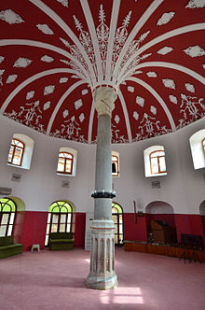
Recap
Why do Alevis go to a Cemevi?
Feelings?
Beliefs?
Actions?
Sharing with others?
Notes:
8. Revisiting this slide, encourage pupils to recap and reflect on what they have learnt.

Slide 9
Summary reflections: My learning about Alevism and the Cemevi.
What have you found most interesting in your learning about Alevism?
What do you think is the most important belief in Alevism? Why?
What do you think is the most important practice in Alevism? Why?
How would you explain Alevism to someone who doesn’t know about it in no more that three sentences?
Notes:
9. This can be done on something like Post it notes- children to have an opportunity to discuss what they have learnt over the 3 lessons. T to put ideas together and sum up ideas into a paragraph and stick into their books You could provide a worksheet with questions to serve as a reminder of the key features of Alevism and the role of the Cemevi. Or as a learning journal entry in their books.

