Slide 1
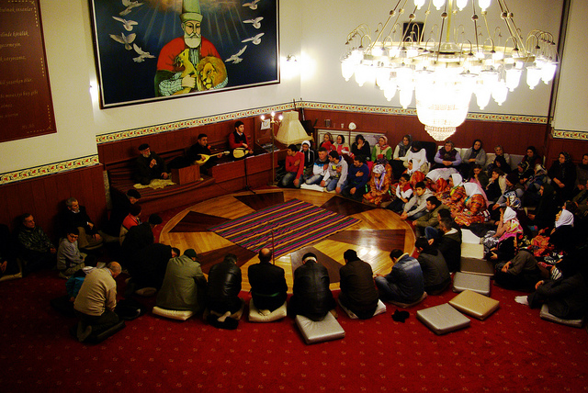
We asked a small group of Alevi about the Cem ceremony to try to find out why it is an important part of their community and their life.
What is the significance of the Cem ceremony?
Notes:
Hand out either sheets to groups or 3 or 4 students. Ask each group to focus on either 1, 2 or 3 and identify anything interesting from what they have read and get the class to ask questions about it.
They can use this for the rest of the lesson to take notes, highlight, underline etc so that they link aspects of Cem to what the people have said. This will also help with the homework.

Slide 2
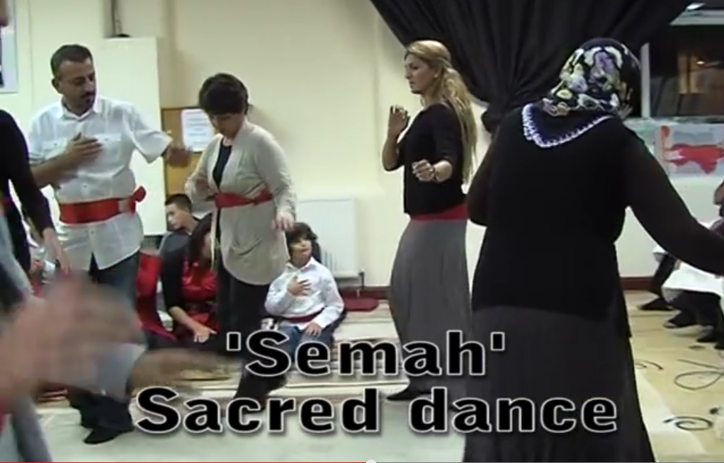
What is the Cem Ceremony?
The cem is the main ritual of Alevism and is the act of communal worship.
It is based on a sacred and secret gathering in which the prophet Muhammed met with Ali.
During the cem ceremony, there is saz music, spiritual songs –Nefes, ritual dances- Semah and food is brought and shared- Lokma.
What other religions have music, dance, food?
Notes:
READ THIS OUT:
The main ceremony in Alevism is the Cem ceremony. It is a very important part of the community’s life. However, the real significance cannot be seen – it lies hidden in the symbols, rituals and hymns of the service. Today, we are going to find out what the meaning is and how the service helps the community.
The cem is the main ritual of Alevism and is the act of worshipping together..
It is based on a sacred and secret meeting between the prophet Muhammed and Ali, when the prophet Muhammed was returning from Mihrac ( a heavenly journey in which he meets Hakk - God).
During the cem ceremony, the “zakir” plays the Baglama- the saz and sings spiritual songs- Nefes, ritual dances are performed- Semah and food is brought and shared- lokma.
ASK THIS QUESTION
What other religions have music, dance, food?
EXAMPLES MIGHT INCLUDE CHRISTIANS SING HYMNS
SIKHS SHARE FOOD

Slide 3
Preparing for the Cem Ceremony: Dispute Resolution
The Cem starts with the consent of every attendee.
A Dede cannot lead the Cem without this consent.
Cems usually start with a Dispute Resolution.
(If two or more attendees have an issue with each other and they wish to participate in the Cem then their dispute must be resolved before they can be allowed to stay in the Cem.)
HOW MIGHT YOU TRY TO SORT OUT A DISPUTE BETWEEN MEMBERS OF THIS CLASS?
Watch this clip and see how the Alevis resolve conflict.
http://www.youtube.com/watch?v=lJZ9r1CO9WY
Notes:
ASK THE CLASS Does anyone has a dispute with a classmate?
What is it about and how can you solve it?
IF SO SHOW AS AN EXAMPLE BY TRYING TO RESOLVE IT.
Play video clip of the cem ceremony from 0:00 to 1:35m

Slide 4
Preparing for the Cem Ceremony and the Cem ceremony
http://www.youtube.com/watch?v=K7BVCznaemA
On the handout, write in the roles of the 12 servants of the cem ceremony named on the sheet.
BE QUICK AS A LOT OF THE ROLES COME UP TOGETHER
Notes:
YOU ARE GOING TO WATCH THE YOU TUBE CLIP OF THE CEM CEREMONY. PLAY IT FROM WHERE THE CEM CEREMONY STARTS – 2.37? TO THE END.
TELL THE CLASS:
Fill in the worksheet identifying the roles for each of the 12 servants in the cem ceremony alongside their Turkish names. Ask them to try and identify the symbolic, hidden meanings of the rituals and services.

Slide 5
12 servants of the Cem Ceremony
1. Mürşid or Dede: This is the leader of the Cem.
2. Rehber "Guide“:
3. Gözcü: S/he is the assistant to the Rehber.
4. Çerağcı: S/he is the light-keeper
5. Zakir: Plays the bağlama,recites songs and prayers.
6. Süpürgeci: Cleans the Cemevi hall. Also symbolises hidden Truth
7. Meydancı: Keeps order within the community
8. Niyazcı: Distributes the sacred meal.
9. İbrikçi: Washs the hands of the attendees. Spiritual cleanliness
10.Kapıcı: Minds the Cem doors and houses of attendees.
11.Peyikçi: Calls the Cem.
12.Sakacı: Distributes sacred water.
http://www.youtube.com/watch?v=lJZ9r1CO9WY
Notes:
Explore with the class what the significance and meanings of the roles and rituals are.
SHOW THE VIDEO CLIP http://www.youtube.com/watch?v=lJZ9r1CO9WY
From 2.00m to 3.35m, and from 8.48m to the end
You may need to stop the video to ask what is going on, explaining what it is and above all why it is important.

Slide 6
Nefes (Songs)
Nefes have spiritual meanings and teach the participants important lessons. One song explains it like this:
"Learn from your mistakes and be knowledgeable,
Don't look for faults in others,
Look at 73 different people in the same way,
God loves and created them all, so don't say anything against them."
What is this song teaching you?
Notes:
READ THIS
Now we are going to look at the activities in the cem ceremony
There is singing, dancing and sharing in the ceremony and we are going to look at each of them.
Nefes – songs
Semah - dances
Lokma – food offereing
READ FROM THE SLIDE AND THEN ASK:
What can you learn from this song?

Slide 7
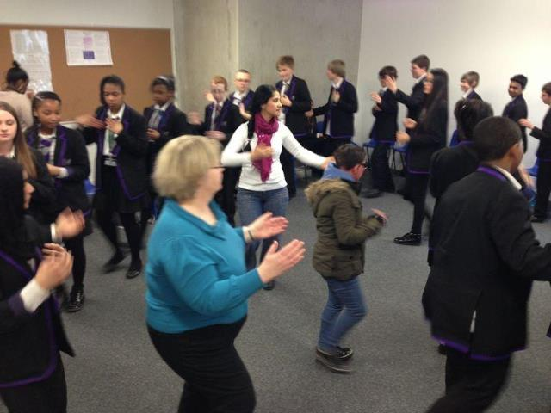
Semah (Ritual dances)
Semah is ritual dancing with turning and swirling to the bağlama.
Notes:
READ THIS
Semah is performed by men and women together, to the accompaniment of the bağlama. The dances symbolise (for example) the revolution of the planets around the Sun (by man and woman turning in circles), and the putting off of one’s self and uniting with God.
This photo is year 9 class doing the semah last year.

Slide 8
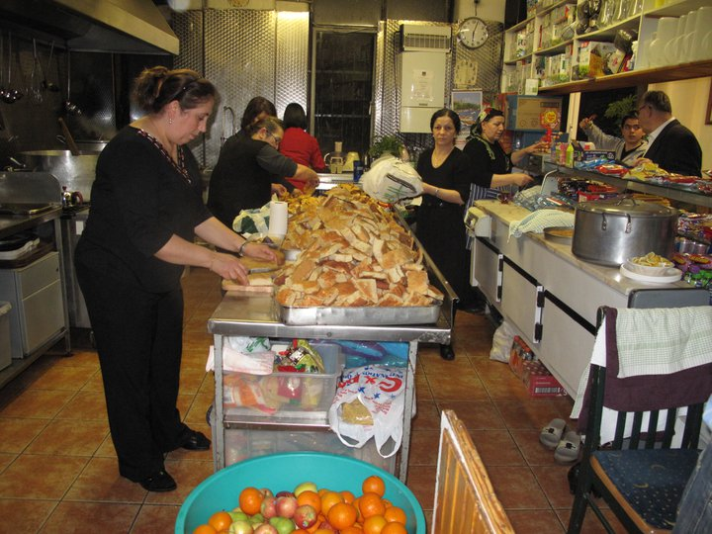
Lokma (Sharing food)
Lokma is a food offering that participants bring to the Cem Ceremony where it is shared equally with others at the end of the Cem.
What is the importance of sharing food?
Notes:
READ THE SLIDE
Lokma is a food offering that participants bring to the Cem Ceremony where it is shared equally with others at the end of the Cem.
ASK:
What is the importance of sharing food?

Slide 9
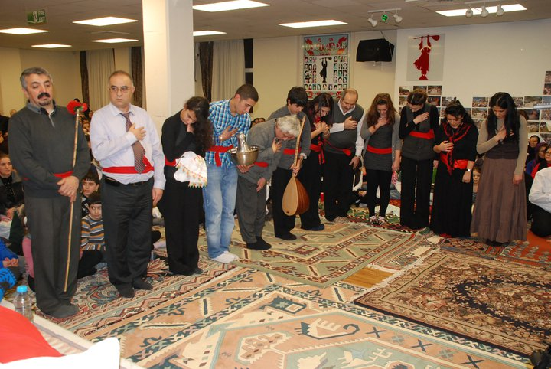
The Truth
Cem ceremonies are held to reach the ultimate Truth by serving others.
The truth is one but ways to it are many
Alevis know this and accept all religions.
Notes:
READ THIS
CEM Ceremonies are held to reach the ultimate Truth by serving others.
The truth is one but ways to it are many
Alevis know this is why they accept all religions.
How do you know what is the truth? How do we judge when someone is telling the truth? Is the truth knowable?

Slide 10
THE CEM CEREMONY HWK
A. Using pages 5 and 8 of the booklet, give examples of the importance of the cem ceremony to Alevi:
For how they see and relate to the world p5
How they express what is important through music, ritual and dance p8.
B. Write your own view for each of these on the other side of the page.
Notes:
ASK THIS QUESTION
What have you learnt about the values of Alevism?

