Slide 1
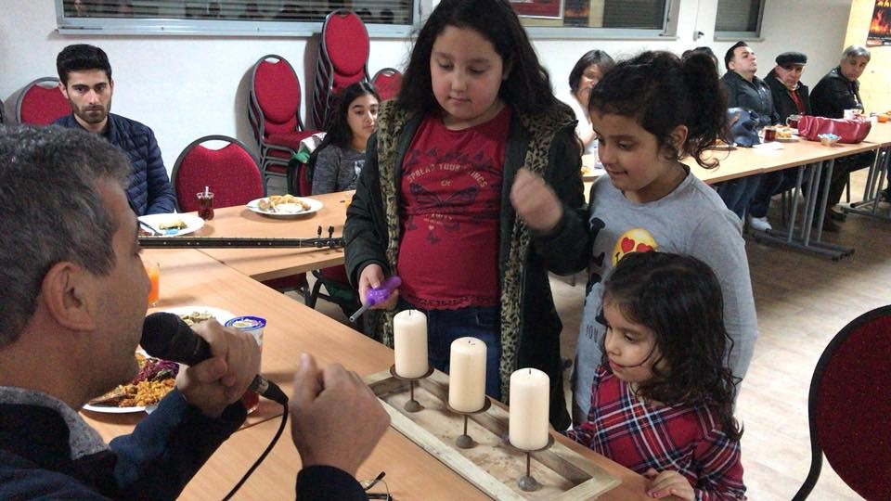
What is most important in life for Alevis?
Notes:
This is a deep and challenging lesson with potential for creative cross-curricular work.
Explain that you will introduce them to some very deep ideas and you want to see how they respond and what they think. Make it clear that as long as they use reason and good thinking, they will be ok. Encourage them to challenge and question each other, politely. They are Seekers After Truth (SATs!!!).
You might want to provide the teachings together and then discuss them all at one, rather than by each slide. Keep to the focus – what is most important for Alevis, but also encourage pupils to link this to their own ideas and thinking.
The children in the picture are about to light three candles representing Hakk (God/Truth)/Muhammet/Ali. Alevi children learn, through participation and encouragement, about their beliefs and traditions.

Slide 2
Pir Mansur Al-Hallaj (858 –922)
One of the most quoted lines for Alevi belief:
“Ene’l-Hakk”
“I am one with God, who is the Truth”
Another of his teachings is:
"the important thing is to proceed seven times around the Ka’aba of one's heart."
Notes:
2. Maybe get pupils to discuss in pairs and then fours before sharing ideas and questions.
Points to pick up – what does this say about human nature and what it means to be a person? – What does it say about God?
Revise what the Ka’aba is in Islam and help to discuss what might be meant by the phrase ‘Ka’aba of one’s heart’.

Slide 3
Haci Bektas Veli
The most important saint in Alevism (1209-1271)
He said: “It is not enough to seek truth; we must also live truthfully.”
What do you think this means?
Notes:
3. Discuss the difference between searching for truth and living the truth. Which is harder? Why?

Slide 4
Haci Bektas Veli
He taught that God/Hakk is in everything.
He is pictured with a gazelle and a lion because he said:
‘Greed and malice disappear by love in our midst. The lion and gazelle are friends in our embrace.’
Once we accept that Hakk is in everything we cease being violent. It shows true humanity.
Notes:
4. What do they think? Malice means wishing harm on others; greed is wanting everything for yourself. Can these be driven out by an inner attitude of love? What else might be needed to make people less greedy and cruel?

Slide 5
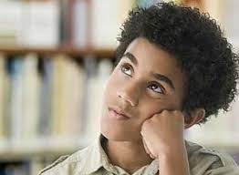
More of Haci Bektas Veli’s teachings
“Whatever you are searching for, search in yourself
Not in Jerusalem, not in Makkah.”
“My Ka’aba (temple) is the human being.”
What do you think these mean?
How might they influence Alevi people?
What difference might it make if everyone held these beliefs?
Do you agree with them?
Why?/Why not?
Notes:
5. Facilitate open discussion – a search for truth! Try not to impose your views, but use questions to encourage their views.
The main idea here is that we find Truth (God/Hakk) in ourselves, not in external places and things. See if pupils can explain the reference to Jerusalem and Makkah, but you may need to explain their significance. Look into yourself, who you are, wha is important in life, what kind of a person you are and want to be. This applies to everyone – so what would life be like if everyone was greedy? Generous? Caring? Cruel? etc
Ask what they remember about the Cem ceremony. The Semah helps them look into themselves and the music and hymns provide teachings and emotional attachment to the process. All these help the Alevis to reflect more deeply about and get more meaning from their worship.

Slide 6
Pir Sultan (1480-1550)
One of the most famous poets and musicians, who died for his bliefs.
His hymns are used a lot in the Cem ceremony. They are very symbolic and use a lot of metaphor and imagery. This makes them hard to understand without a lot of time and deep thinking!
His poems carry deep meaning that helps Alevis think about the meaning of life.
Notes:
6. Pir Sultan’s poems are sung and danced to producing a deep spiritual experience or sense of being at one with yourself, humanity and Hakk. The Saz accompaniment adds to the tone of the experience and has the effect of helping the participants to reflect deeply on their own life and the world.

Slide 7
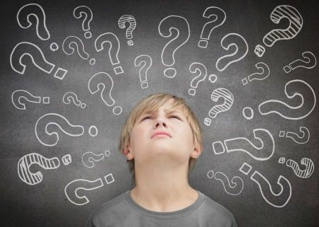
The BIG question
What do you think is the meaning or purpose of life ... if anything?
Notes:
7. P4C-style: ask for an initial response to this and facilitate their further responses. This can be fairly informal for those who have not done P4C, are can be used as a full P4C session in schools with training, allowing the pupils to develop their own questions on the stimulus of their learning about Alevi teachings and values and choosing one to explore.
Give it a go!! See what they come up with. Be amazed! Get them to write and draw their ideas after discussion
Keep this open. Better to let the pupils question each other than you restrict or impose ideas on them.
Encourage them to be Truth-Seekers! Or, post SATs, Seekers After Truth! Again, this can be the basis for some creative cross-curricular work.

