Slide 1
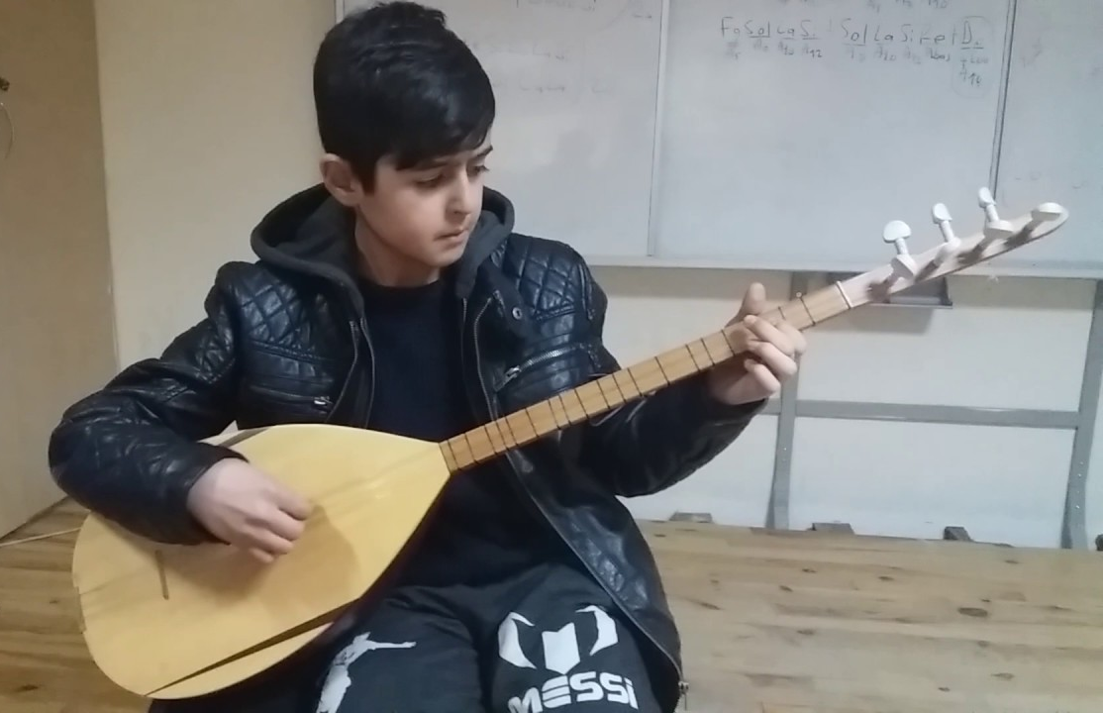
Why is music important to Alevis?
LO:I can understand how Alevism is expressed through music.
Notes:
1. We express feelings in lots of different ways, but we must remember that feelings arise out of experience. Music and dance are powerful ways of experiencing and expressing feelings and beliefs and in Alevis, the saz is absolutely central. It has a distinctive sound and playing style and when combined with movement and song, it draws the worshipper into deep religious feelings and attitudes. The purpose of this lesson is to get the pupils to experience the music and to reflect on how it expresses feelings for them and how else they can express these feelings through movement, art, words and reflection. See the document ‘Conceptual Creativity’ included in the resources for this lesson to help you as teacher to structure this for the children.

Slide 2
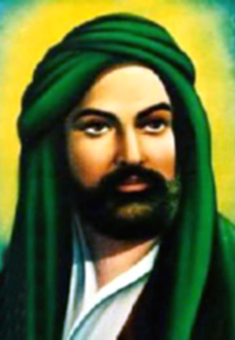
Who was Ali?
Ali is an important person to Alevis.
What letters are the same in Ali and Alevis?
He lived a long, long time ago.
His words have been put to music and made into hymns that Alevis dance to.
Notes:
2. Ask the pupils to describe Ali. Ask them to think about what sort of person he looks like - kind, caring, gentle, strong, determined: eyes, mouth, facial expression, halo
Ask what letters are shared between Ali and Alevis? Alevis took their name from Ali.
Ali is the most important figure in Alevi beliefs.
He thought knowledge was most important -what do you think he would have thought of schools?
He saw knowledge as the path to God/Hakk.

Slide 3
What do you see in this symbol?
This is an important Alevi symbol
What do you notice about it?
What is the man holding?
Notes:
3. What does the symbol tell us about Alevis?
A stringed instrument – it is called the baglama or saz.
You might ask why he is holding the saz up high rather than just playing it. What do people do when they win a cup or medal at sport? Why? Could this be similar?
In Alevism, they do not have a Holy Book like the Bible or the Qur’an. They call the saz their ‘Holy Book with strings’. The saz plays while the people sing hymns from the poets and saints. This is how the teachings of Alevism are passed down and learnt, rather than by reading a book.

Slide 4
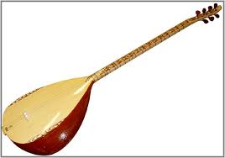
The Saz
Alevis love music! The saz helps them feel and think about things and they express this in hymns and dance.
Close your eyes as you listen.
How does this make you feel? What does it make you think of?
Notes:
4. Click on the picture of the saz
Listen to the music. How does the music make you feel?
Discuss with the class how the music makes them feel. Use the structures from ‘Conceptual Creativity’ to share with pupils how music expresses feelings.

Slide 5
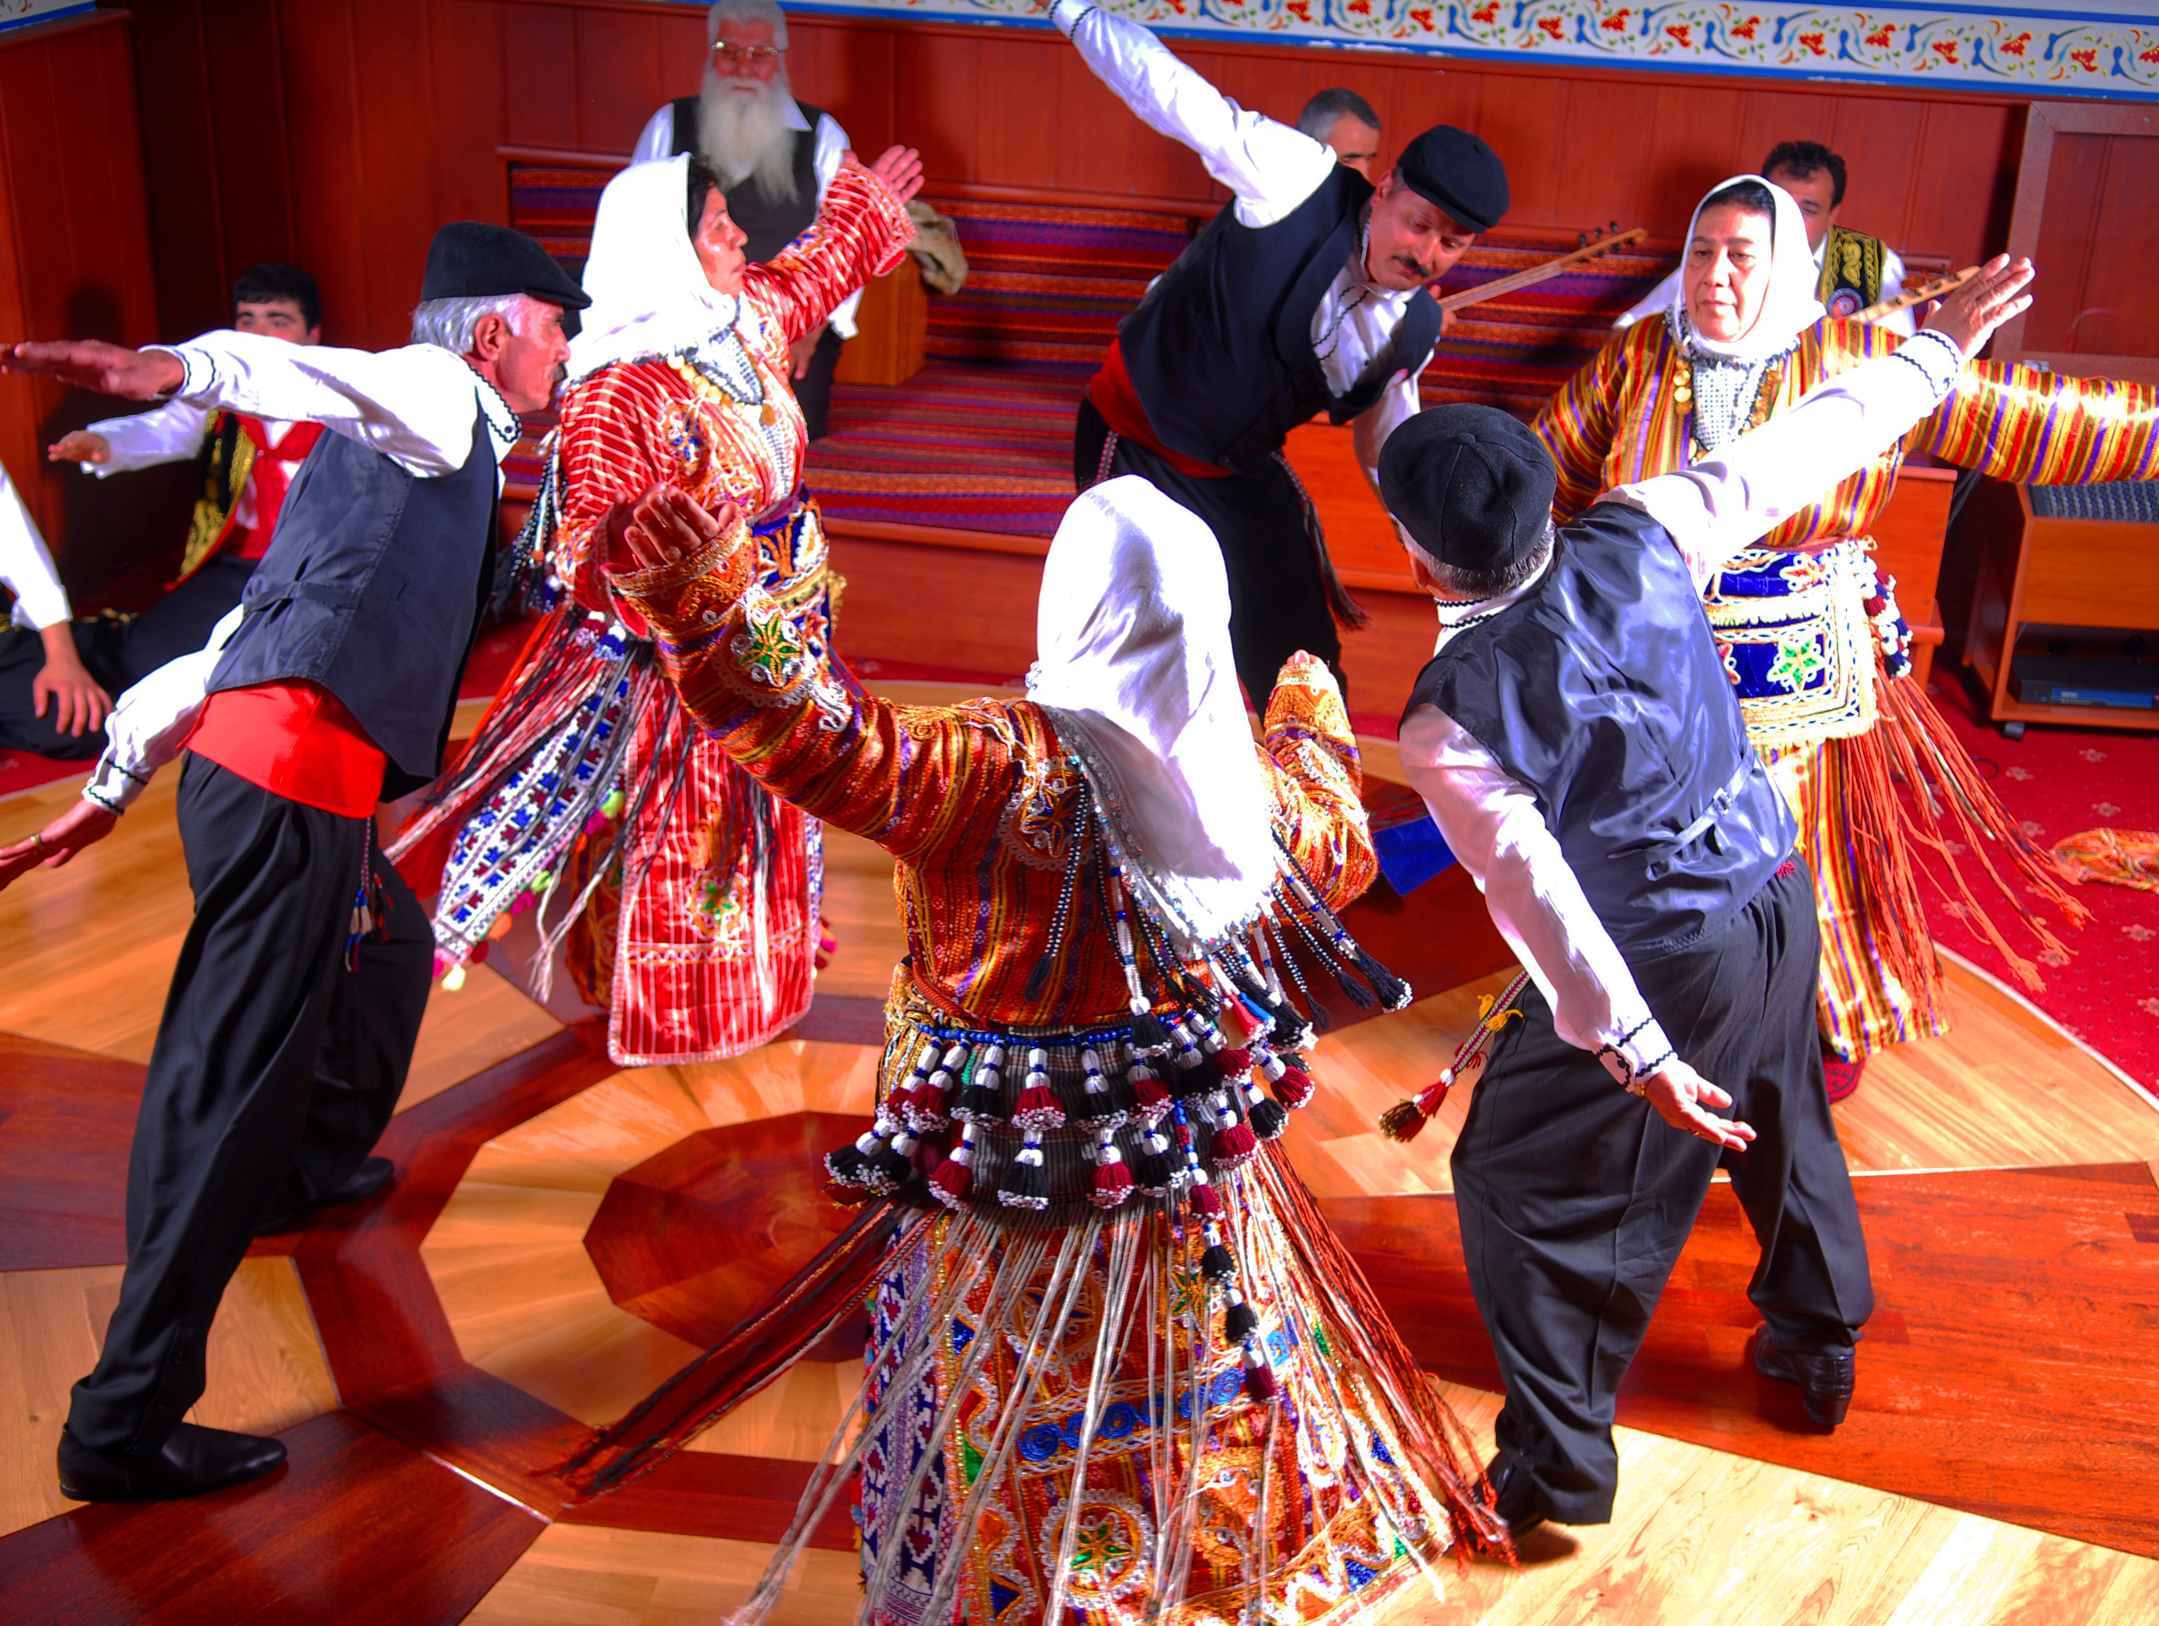
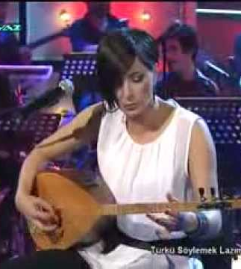
Music, poetry and dance
Alevis worship through their music, hymns and semah, the sacred dance.
This hymn is used by Alevis in their worship and they dance to it.
How do music and dance affect people?
Listen to the music and work out how you would dance to it. If there is space in the room, start dancing!
We will now watch a Semah
Notes:
5. Click on the bottom picture of the musician.
This extract is from a famous Alevi singer. The song is about Ali, one of the most important figures for Alevi people. It is used in cem ceremonies for the semah ritual dance.
Encourage the pupils to listen to the rhythm as well as the tune – and to both the singing and the playing. How do these express feelings? Explore tempo (speed); volume; melody; tone of voice etc. What kinds of movements would fit with this? Get pupils to enjoy this fairly freely and then ….
Explore how they were feeling. What colours, shapes and sounds would express these? Have they had experiences that produce these feelings?
Come back to the question of how music, song and dance affect people.
Get the children to fill in the sheet.

Slide 6
Semah
The Semah is one of the most important parts of Cem.
It normally happens towards the end.
Those who are not dancing usually join in with singing at times.
Semah makes people feel close to each other and to God/Hakk
Notes:
6. The clip for this lasts just over 8 mins, so don’t show it all!
Start and show about 15 seconds, then skip to…
50 seconds when the singing starts and show a few secs. Then skip to….
2 mins 5 secs when the dancing changes. Then skip to…
3 mins 5 secs when the tempo speeds up considerably…
Then skip to 5 mins and this Semah ends at 5 mins 10 secs.
Semah is a very important part of worship and is part of Alevi cem ceremonies. Alevis perform the dance with music played on saz and singing based on the poems of the Pirs (saints). This helps them feel closer to God and each other.
Ask the pupils to close their eyes and listen to the music for the first minute or so and then open their eyes and see what is going on. No need to play the whole video, but get the chn to respond. How did the music make them feel? What did they think of the dance? How do they think the people involved felt? What about the movements, gestures and facial expressions? What were the non-dancers doing? Were they just sitting there watching? How did they join in? Useful just to see what responses you get from the pupils.
Finish by sharing questions that the class has about what they have seen. Write these down to record and come back to either if you visit a Cemevi, have someone in – or just as a plenary at the end of the set of lessons.

Slide 7
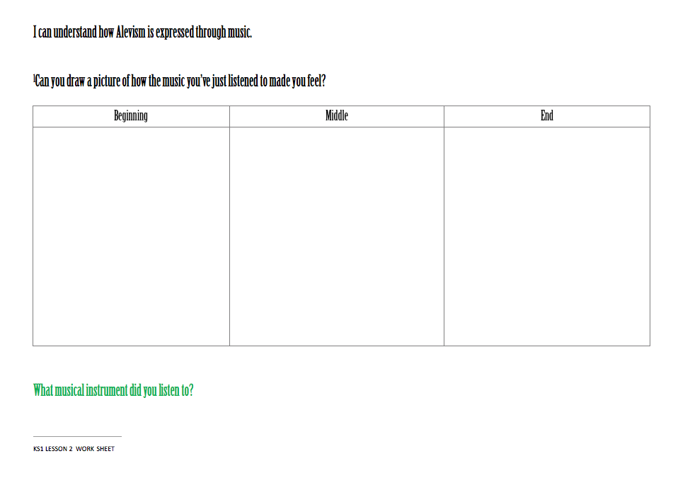
Draw a picture of how the music makes you feel
Notes:
7. Encourage pupils to write words, use colour and shape to express the different feelings they got from the music.
The document on Conceptual Creativity may help you to explore this

